Slide 1
Lysozyme Crystallization
Author Names

Slide 2
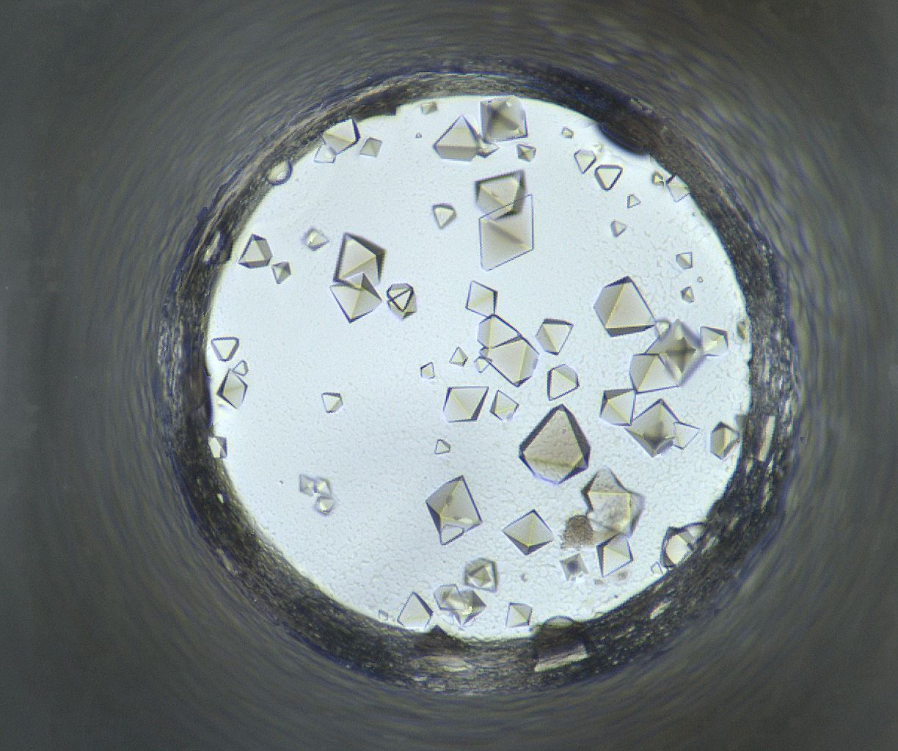
Well Number 108
Well Num: 108 MARCO Class: Crystals Human Class: Crystals MARCO Confidence: 94.2 % Date: 05/19/2020 Spectrum: Visible Cocktail 17_C1059 ------------------ pH: 6.8 Silver Bullet A3 [] [] HEPES 0.06 M PEG 3350 15.0 w/v

Slide 3
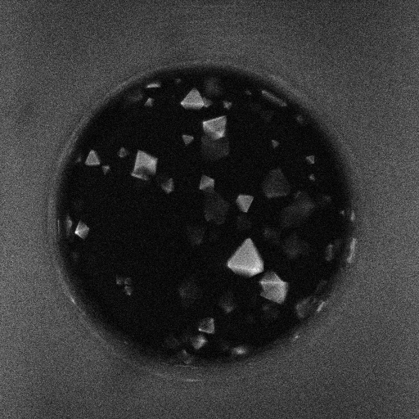
Well 108 Alternate Imagers
Visible
UV-TPEF

Slide 4
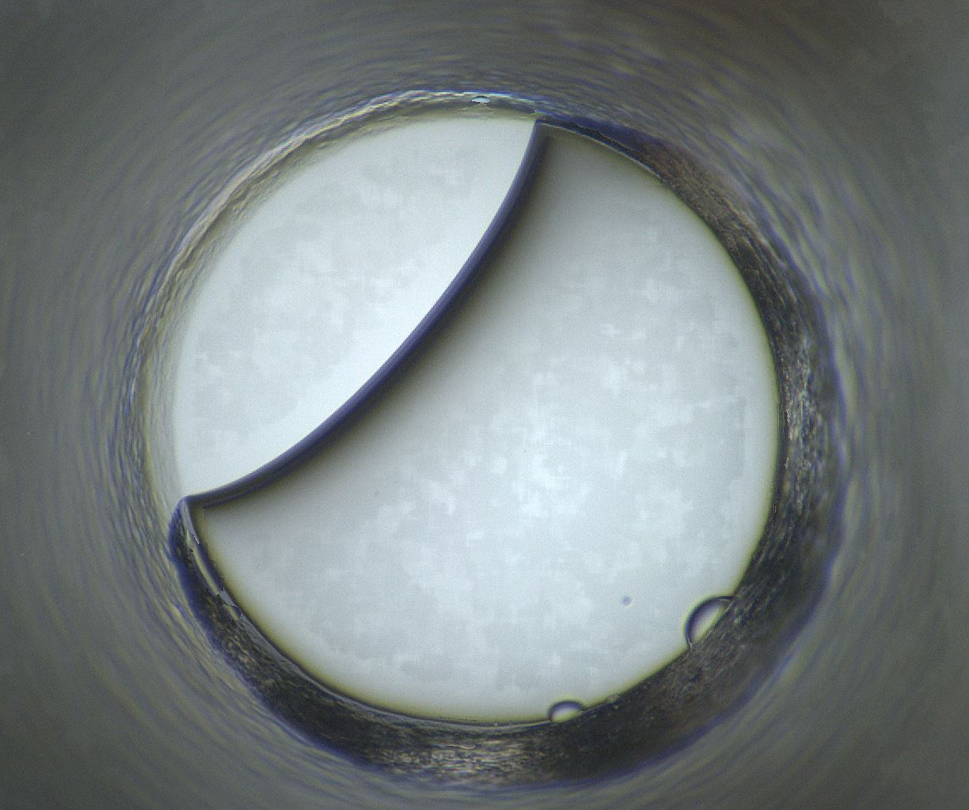
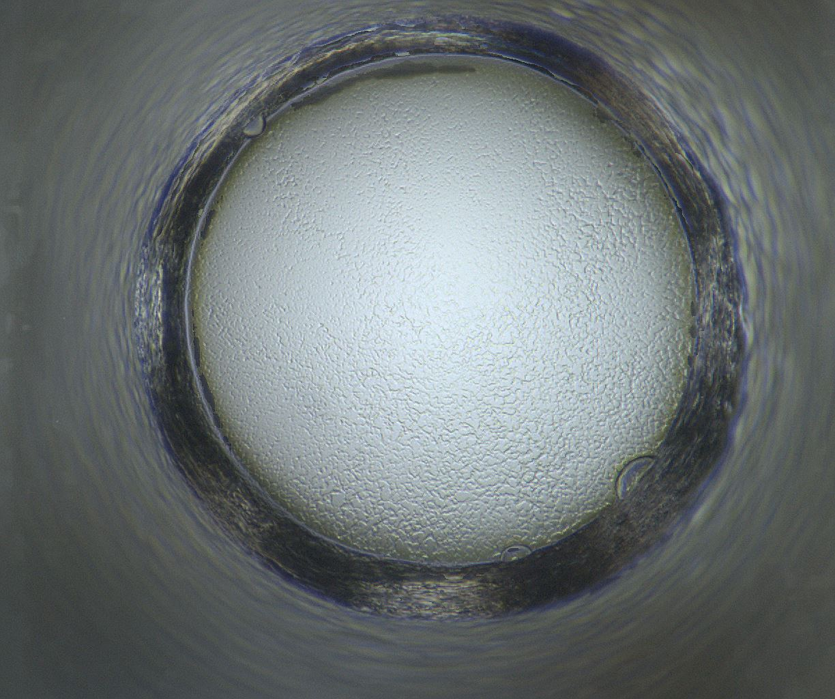
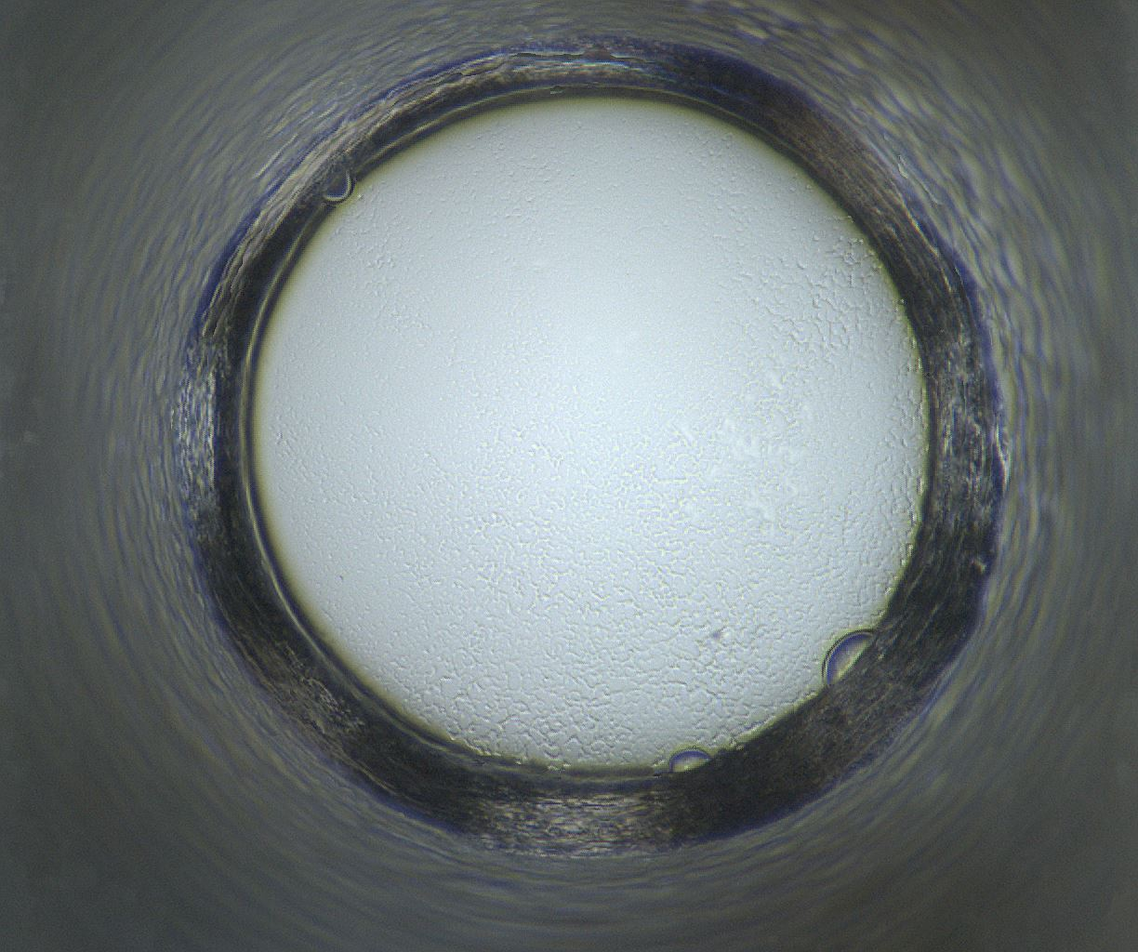
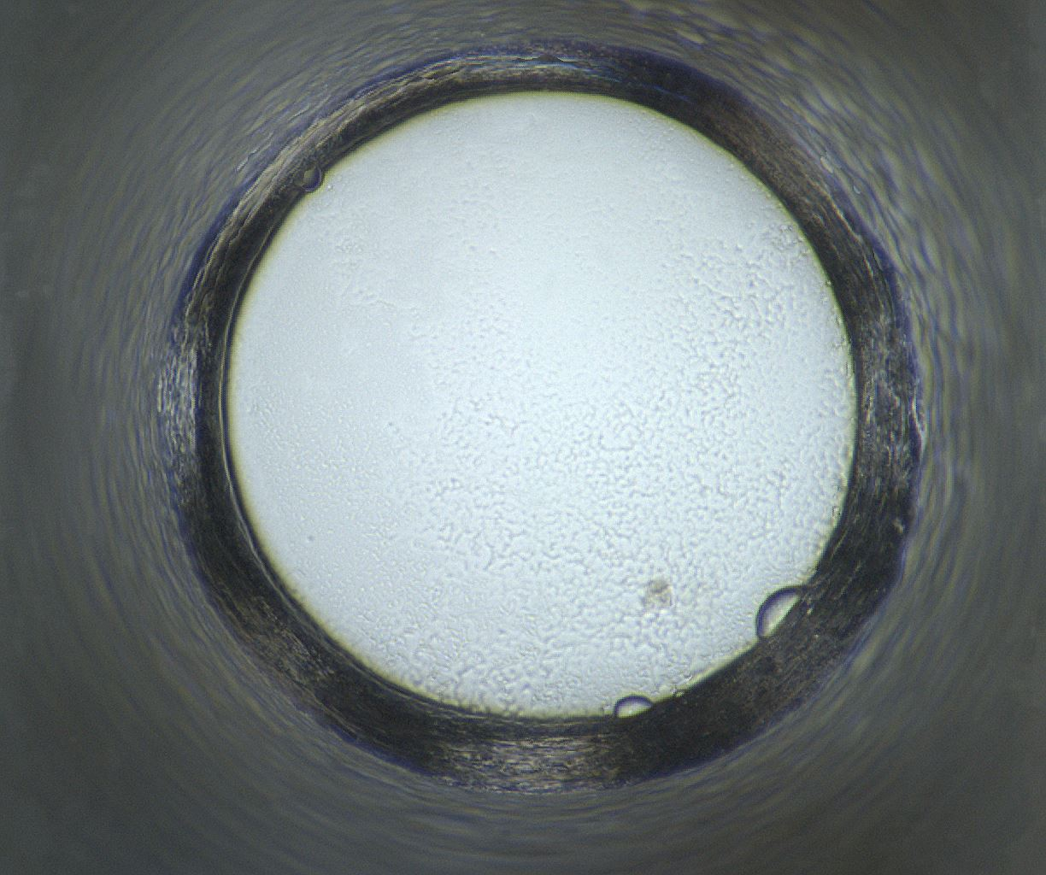
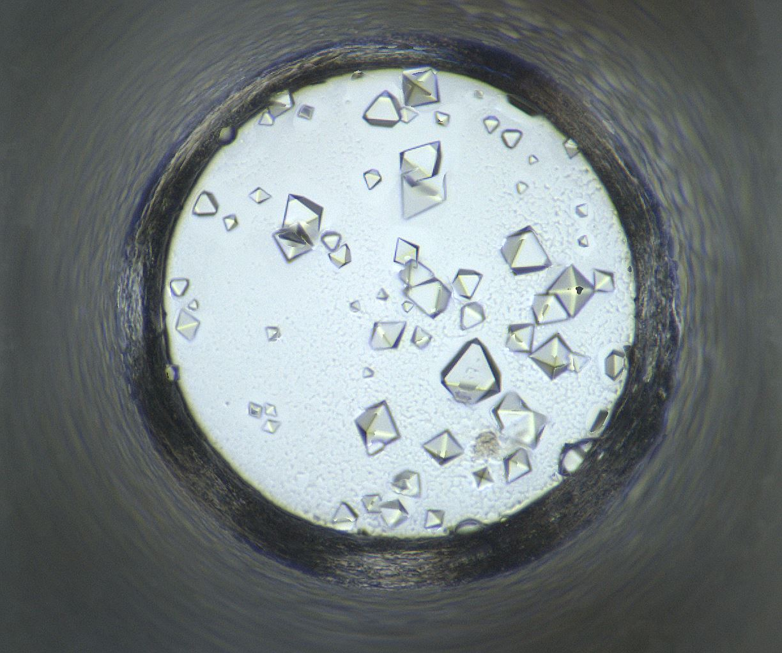
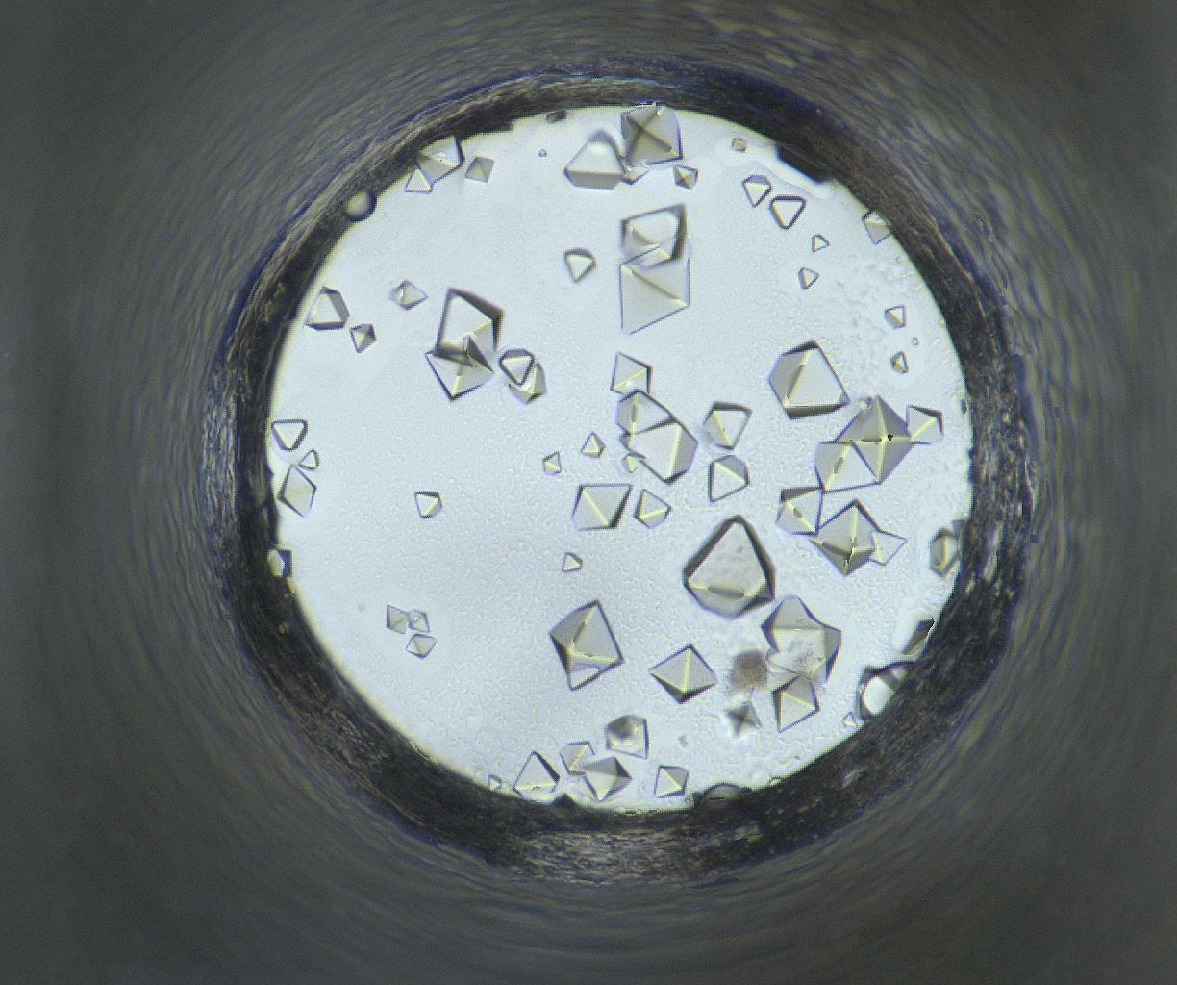
Well 108: 04/07/2020 - 05/19/2020
04/07/2020
04/08/2020
04/14/2020
04/21/2020
04/28/2020
05/05/2020
05/19/2020

Slide 5
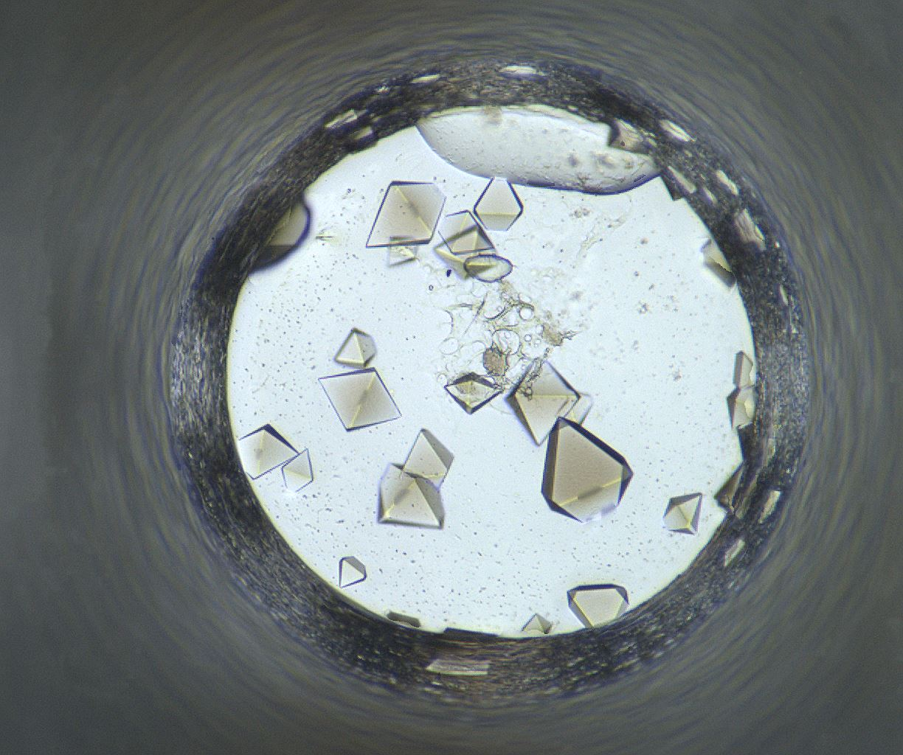
Well Number 136
Well Num: 136 MARCO Class: Crystals Human Class: Crystals MARCO Confidence: 93.6 % Date: 05/19/2020 Spectrum: Visible Cocktail 17_C1066 ------------------ pH: 6.8 Silver Bullet A10 [] [] HEPES 0.06 M PEG 3350 15.0 w/v

Slide 6
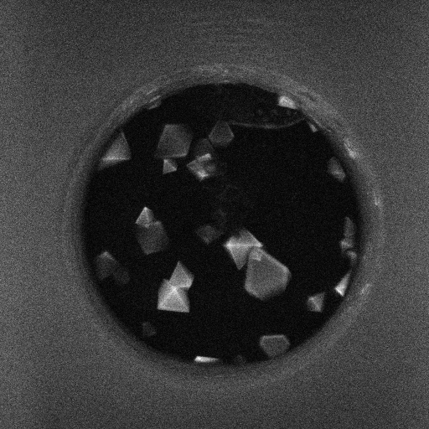
Well 136 Alternate Imagers
Visible
UV-TPEF

Slide 7
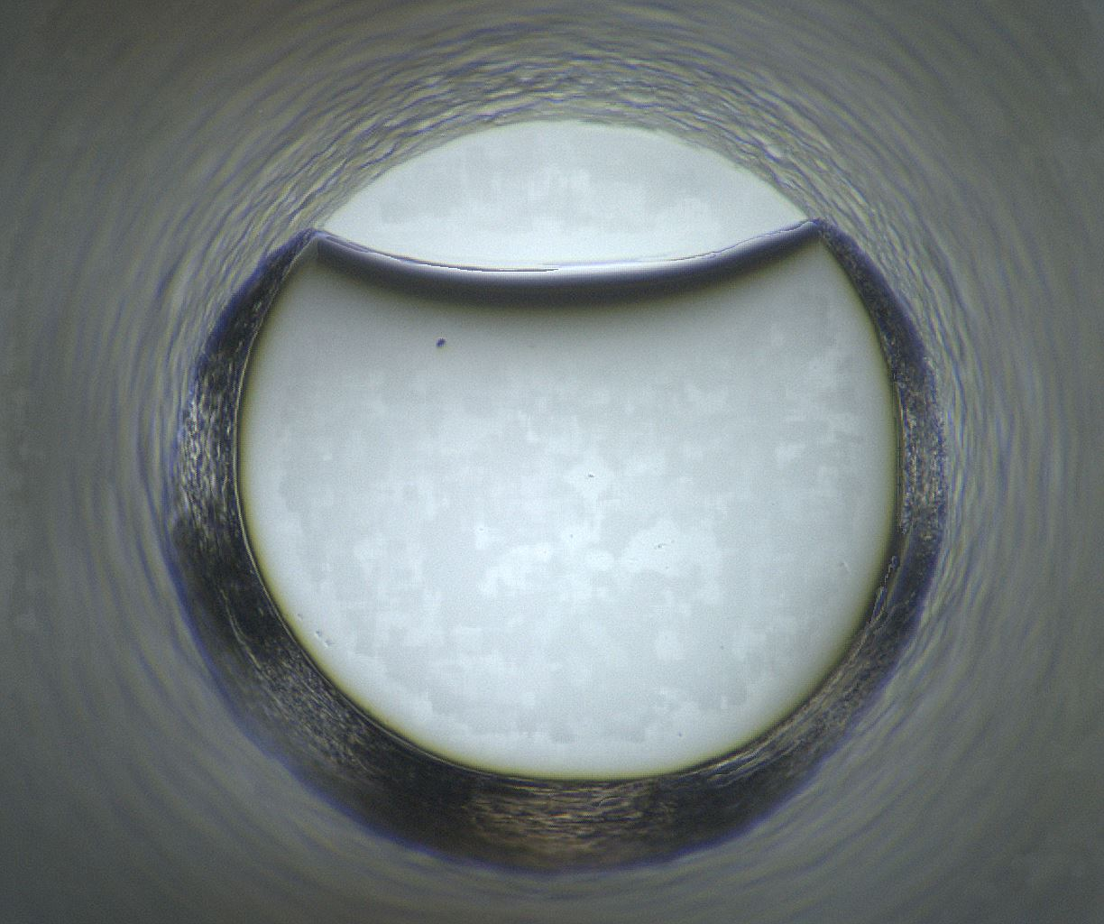
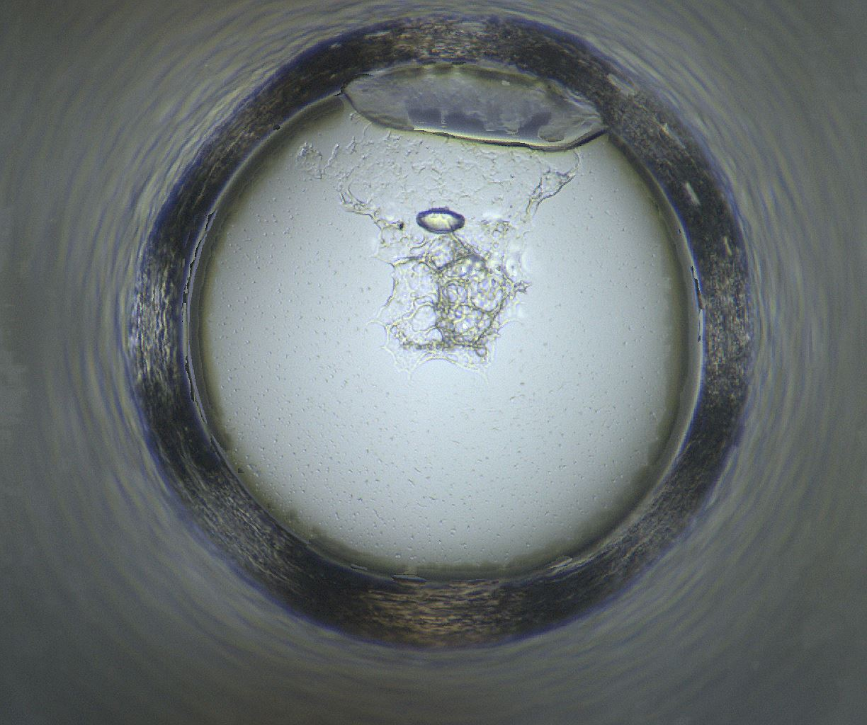
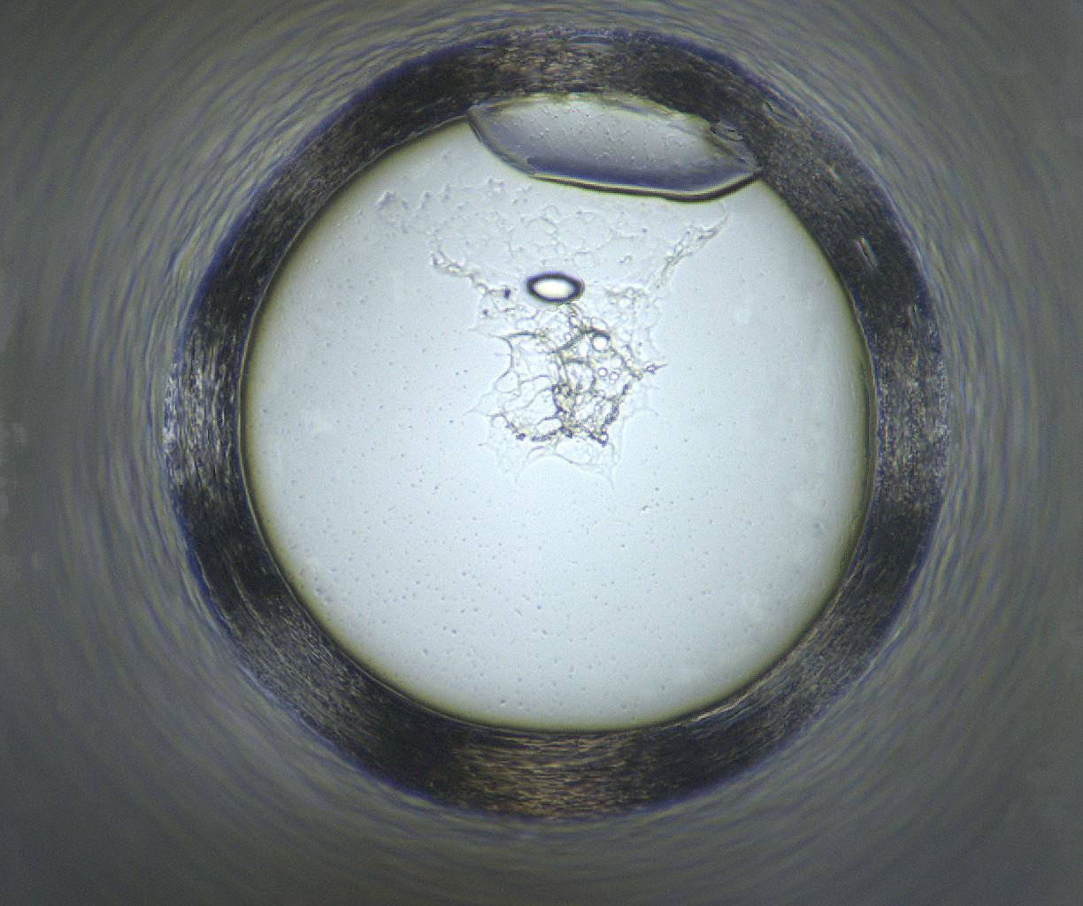
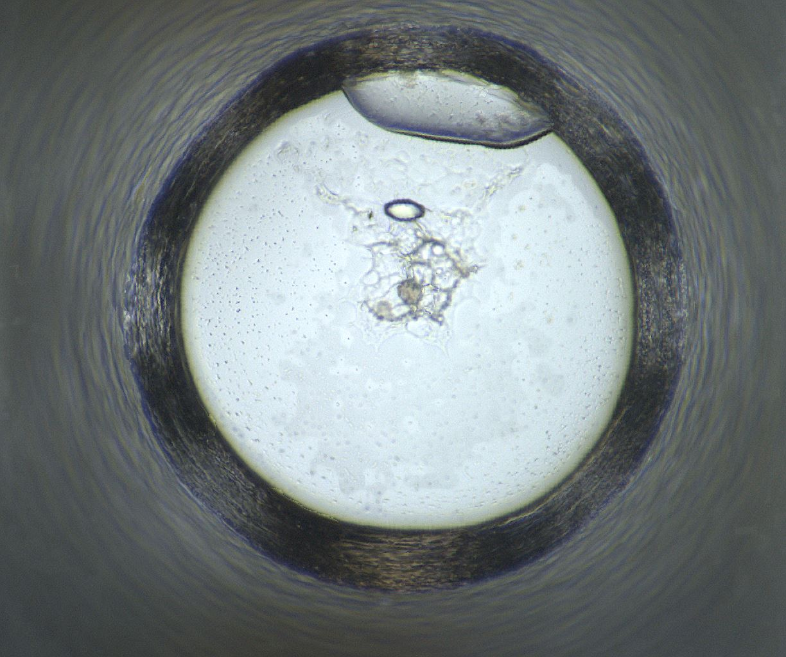
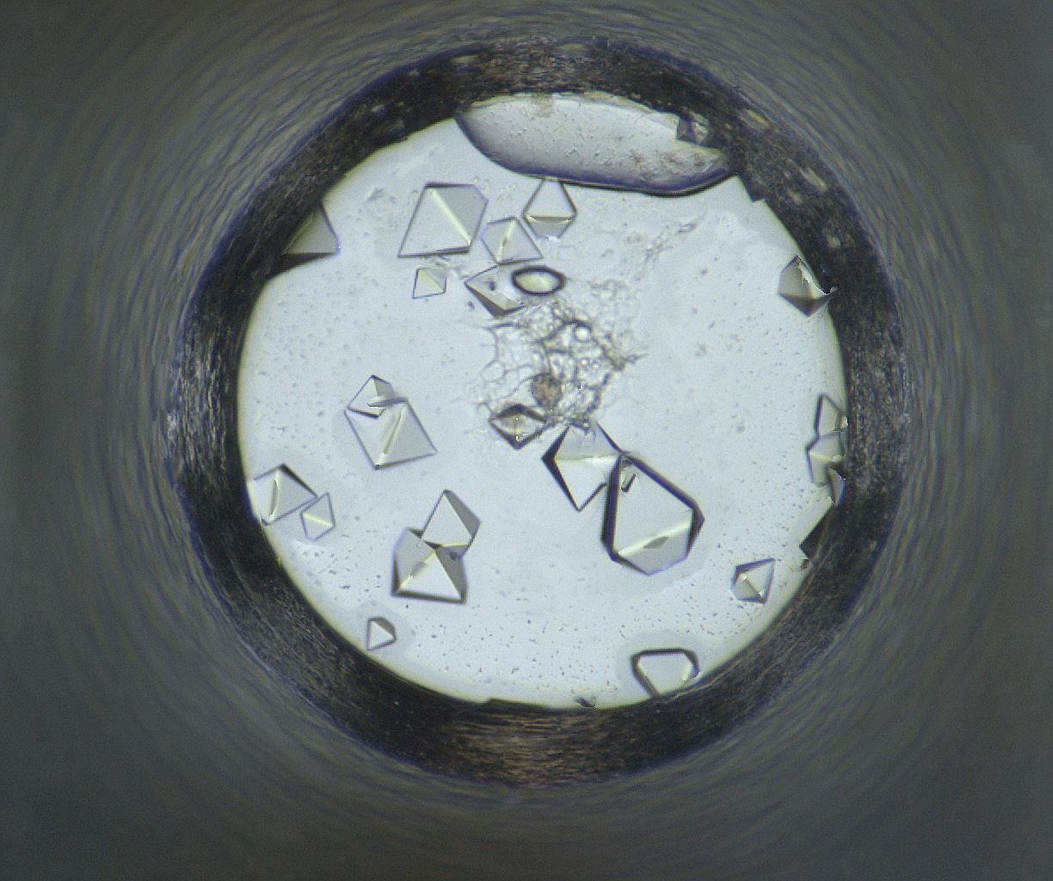
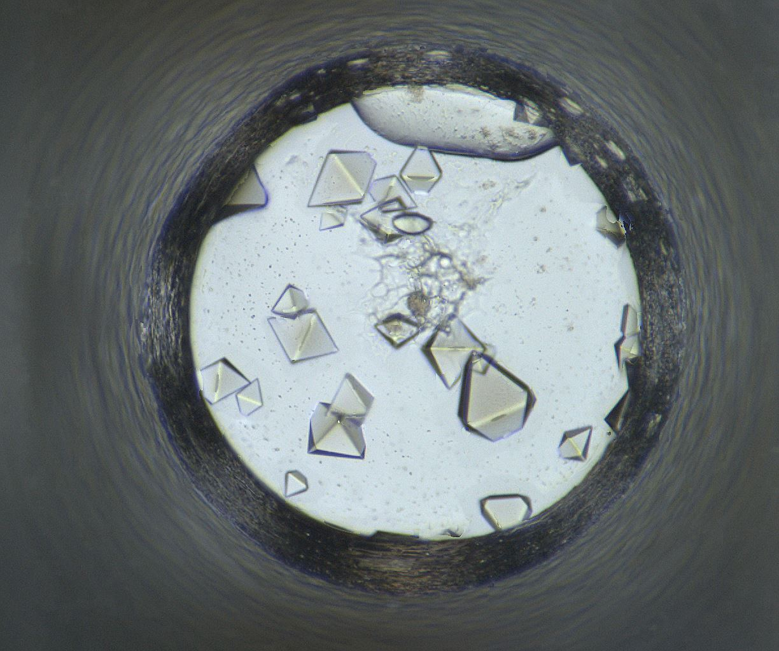
Well 136: 04/07/2020 - 05/19/2020
04/07/2020
04/08/2020
04/14/2020
04/21/2020
04/28/2020
05/05/2020
05/19/2020

Slide 8
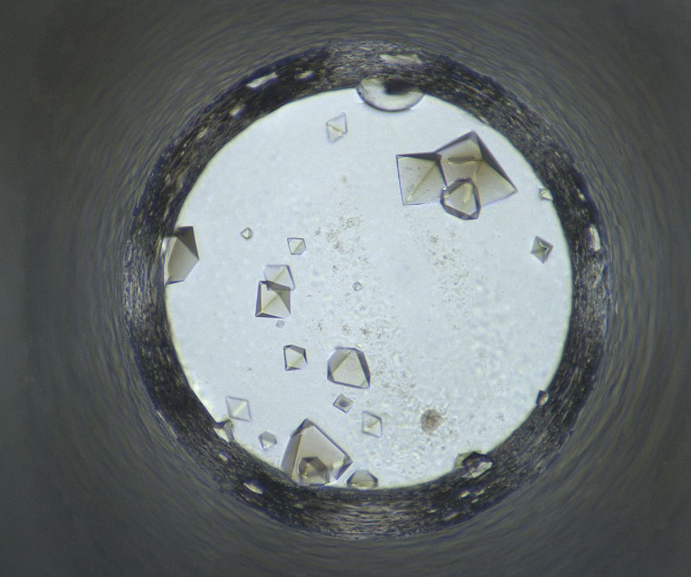
Well Number 508
Well Num: 508 MARCO Class: Crystals Human Class: Crystals MARCO Confidence: 93.4 % Date: 05/19/2020 Spectrum: Visible Cocktail 17_C1087 ------------------ pH: 6.8 Silver Bullet C7 [] [] HEPES 0.06 M PEG 3350 15.0 w/v

Slide 9
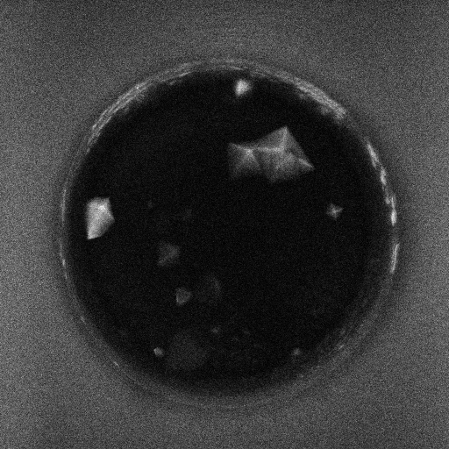
Well 508 Alternate Imagers
Visible
UV-TPEF

Slide 10
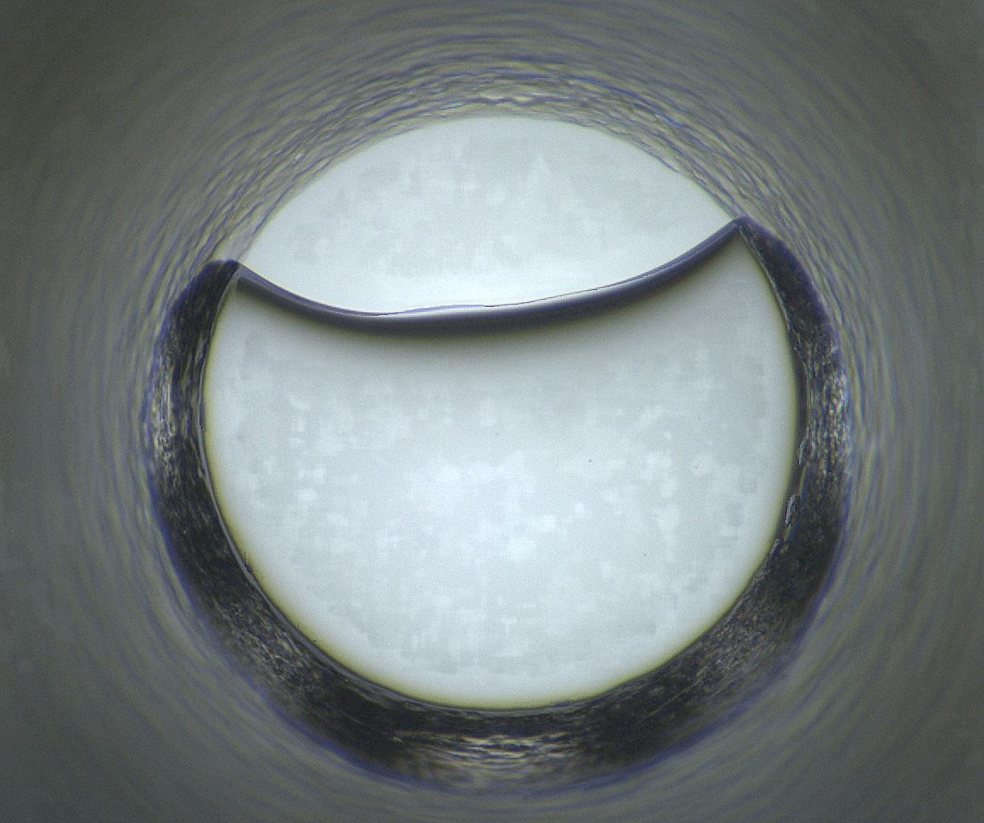
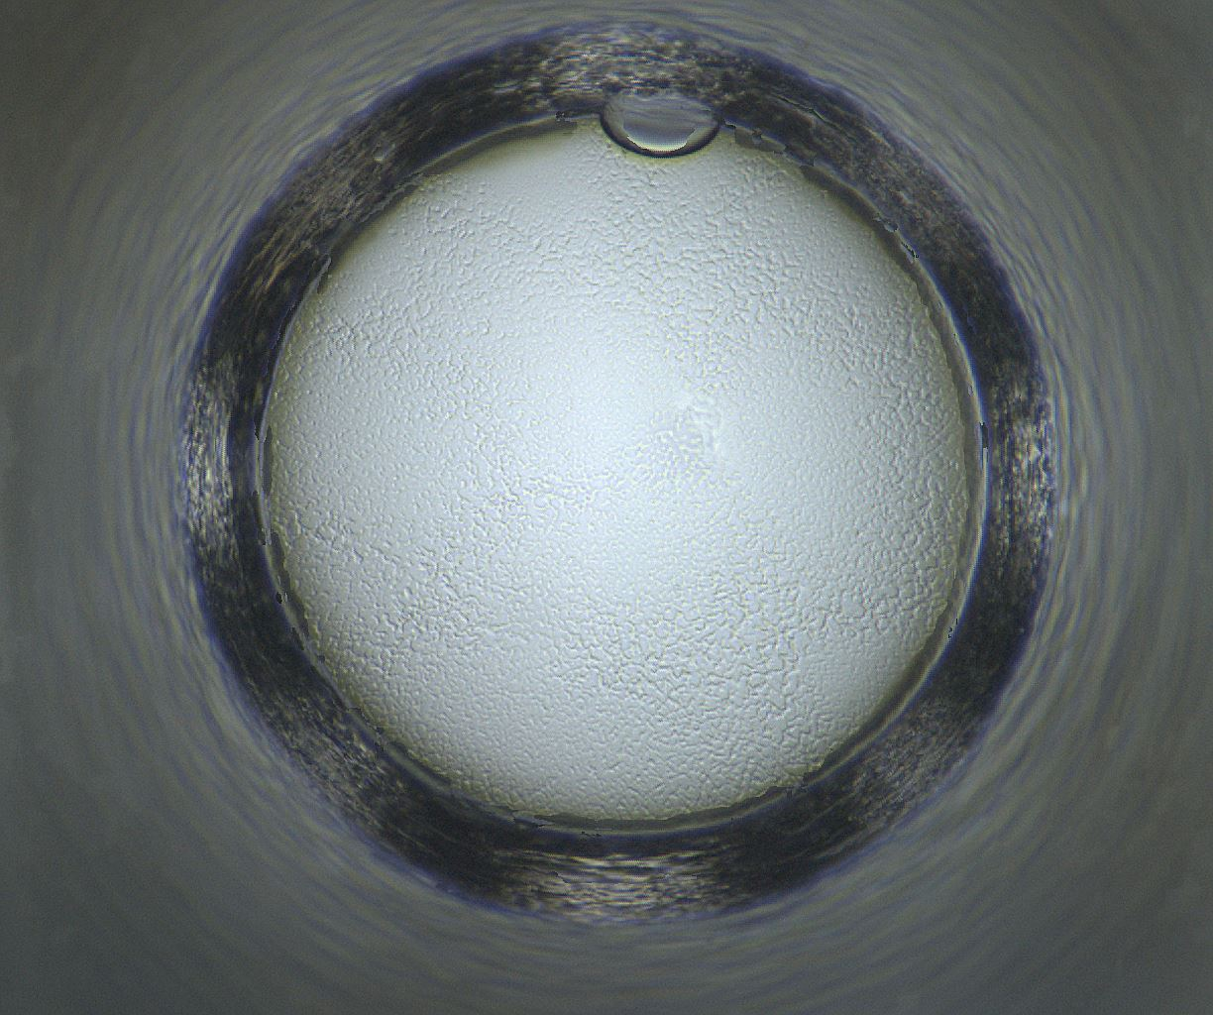
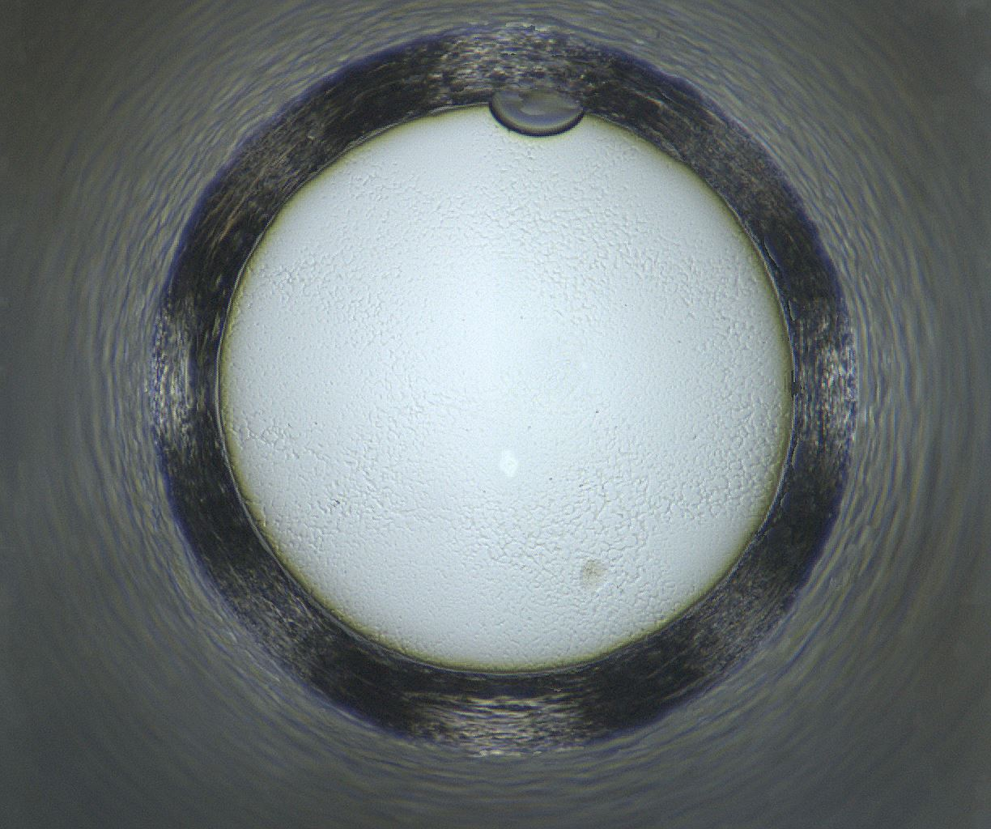
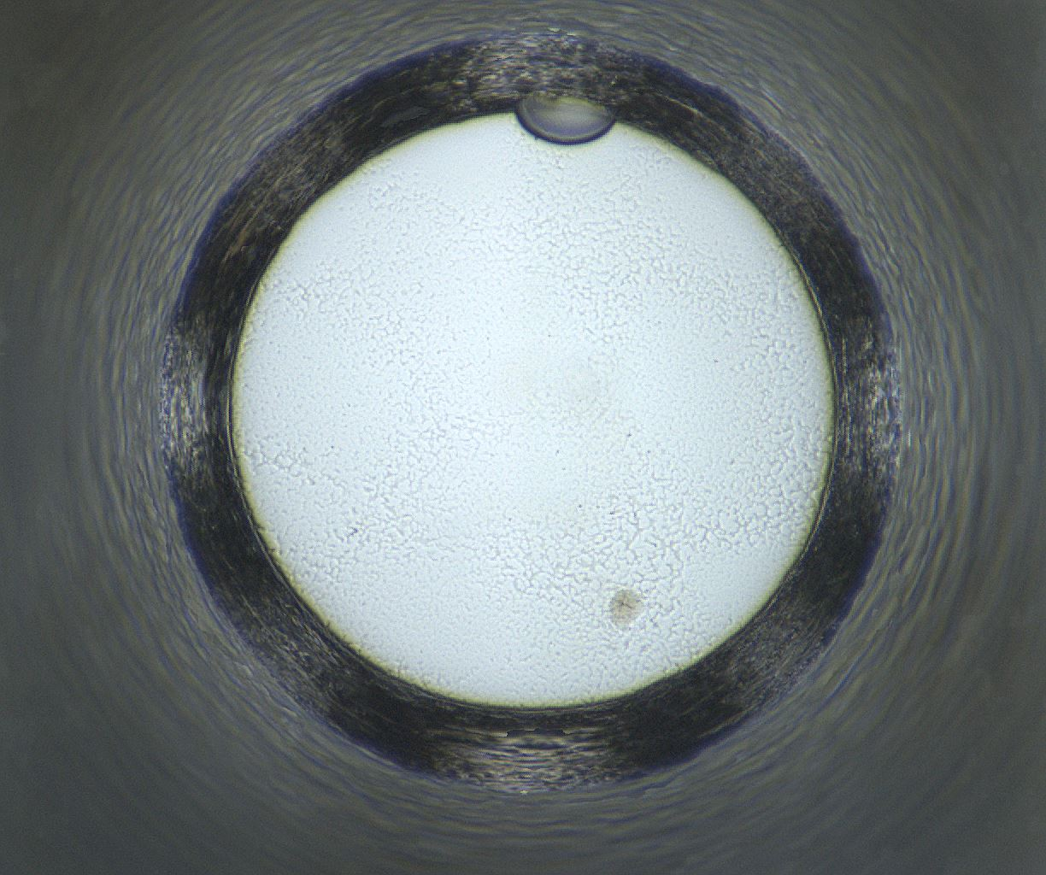
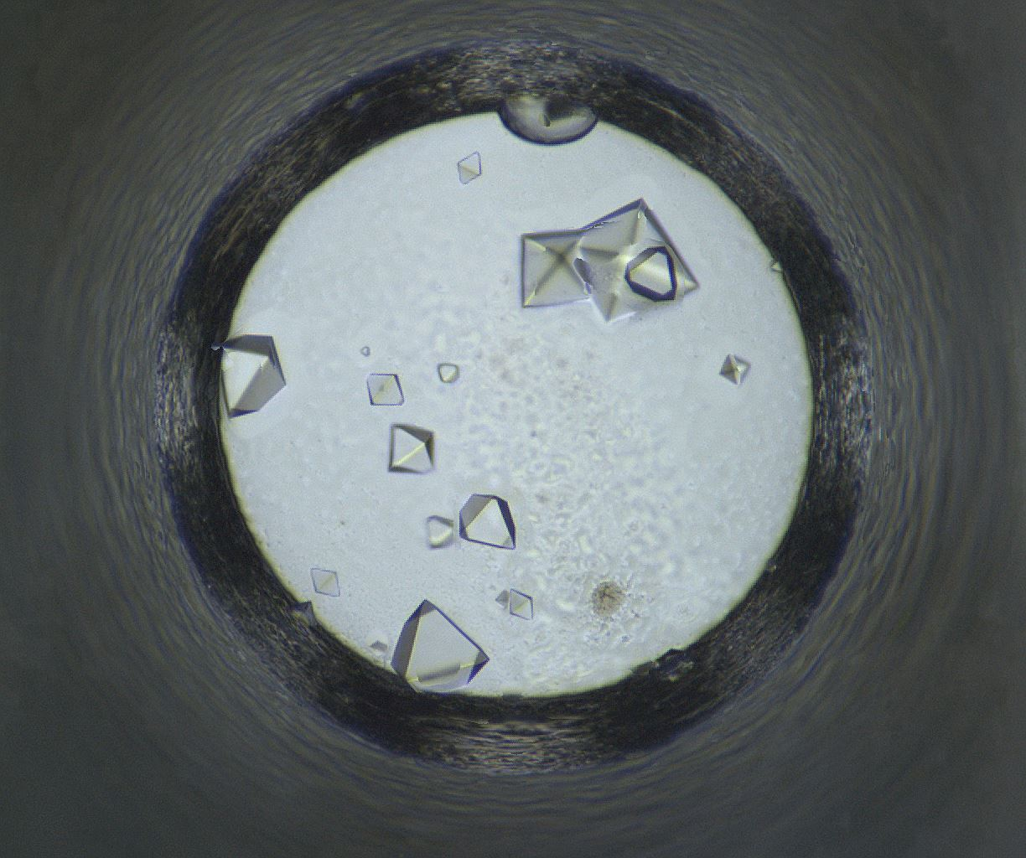
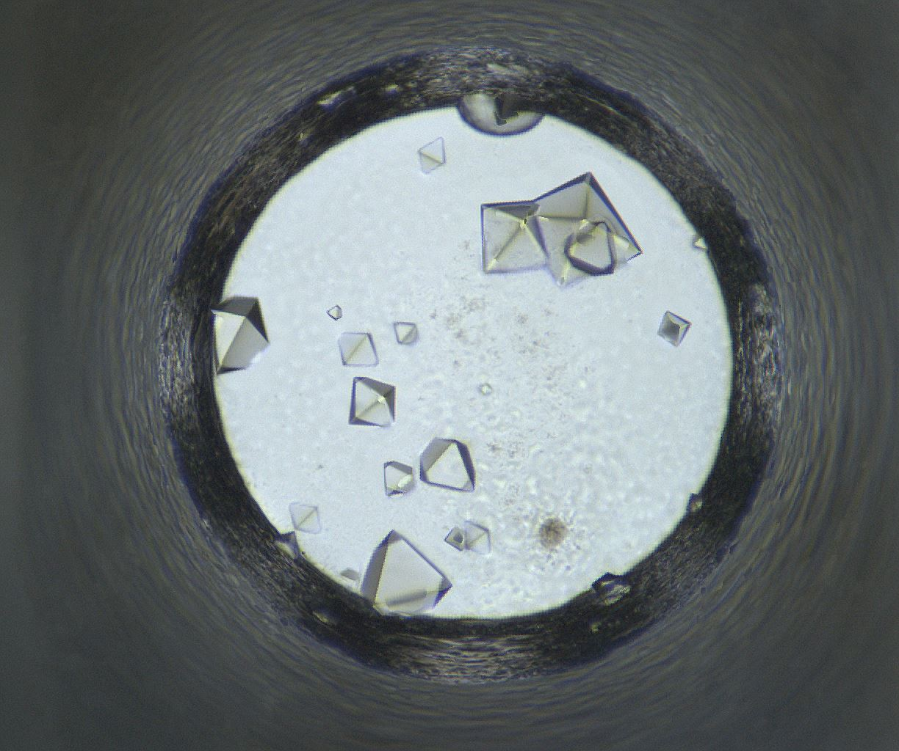
Well 508: 04/07/2020 - 05/19/2020
04/07/2020
04/08/2020
04/14/2020
04/21/2020
04/28/2020
05/05/2020
05/19/2020

Slide 11
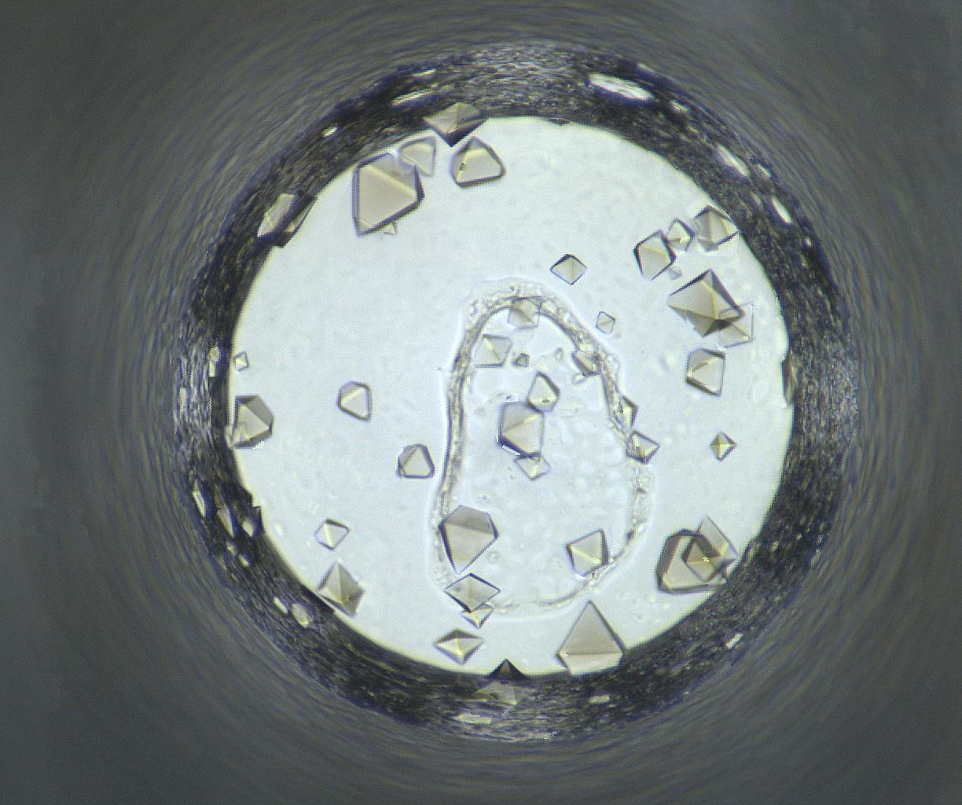
Well Number 700
Well Num: 700 MARCO Class: Crystals Human Class: Crystals MARCO Confidence: 93.4 % Date: 05/19/2020 Spectrum: Visible Cocktail 17_C1099 ------------------ pH: 6.8 Silver Bullet D7 [] [] HEPES 0.06 M PEG 3350 15.0 w/v

Slide 12
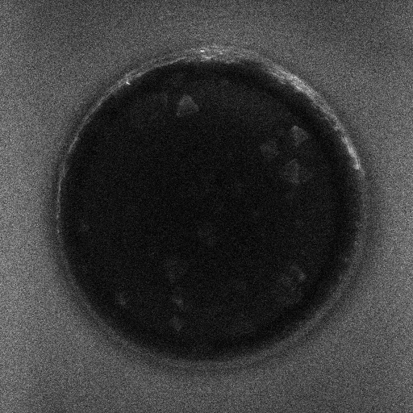
Well 700 Alternate Imagers
Visible
UV-TPEF

Slide 13
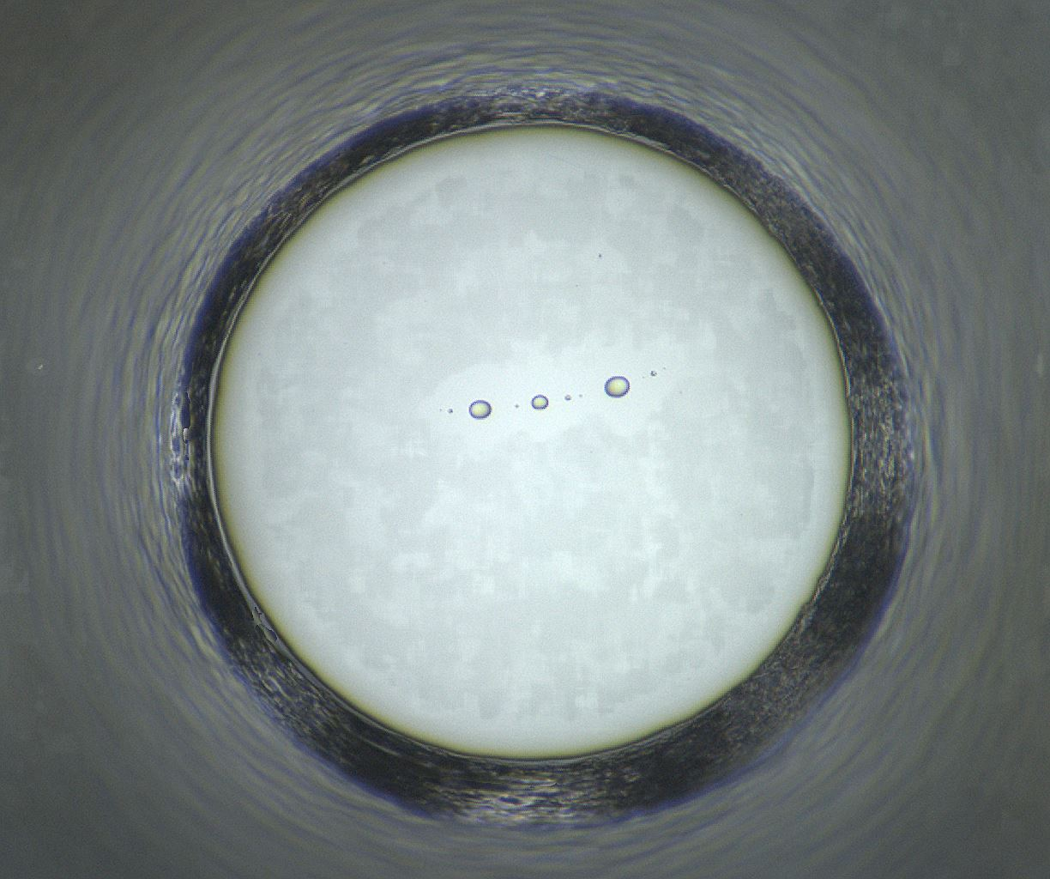
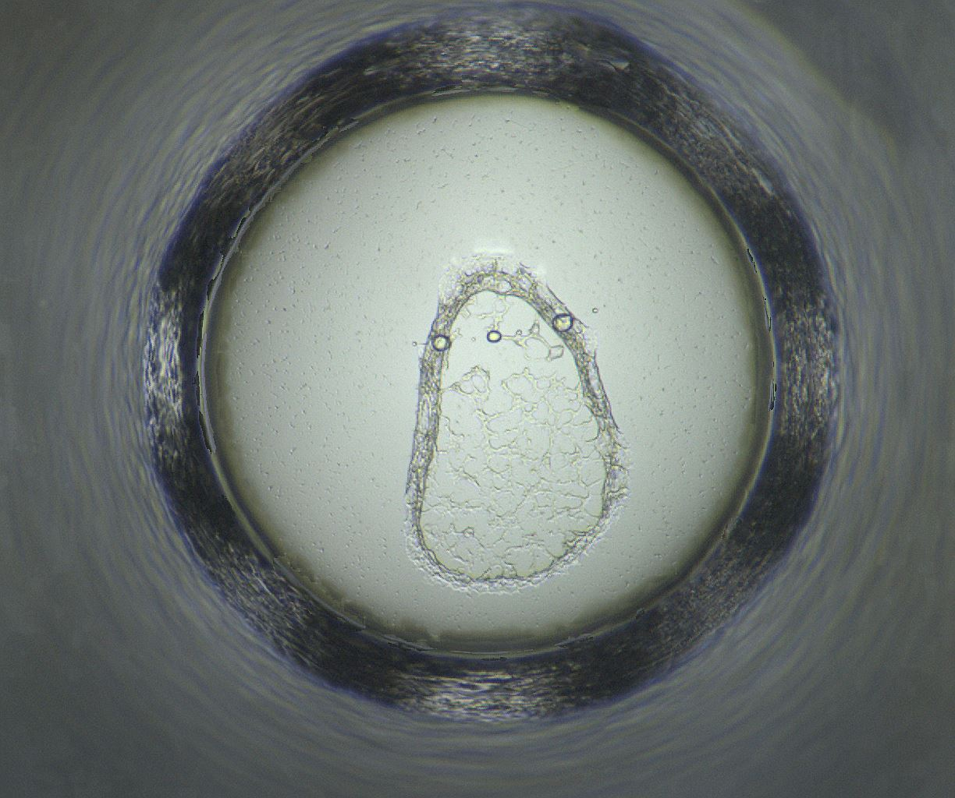
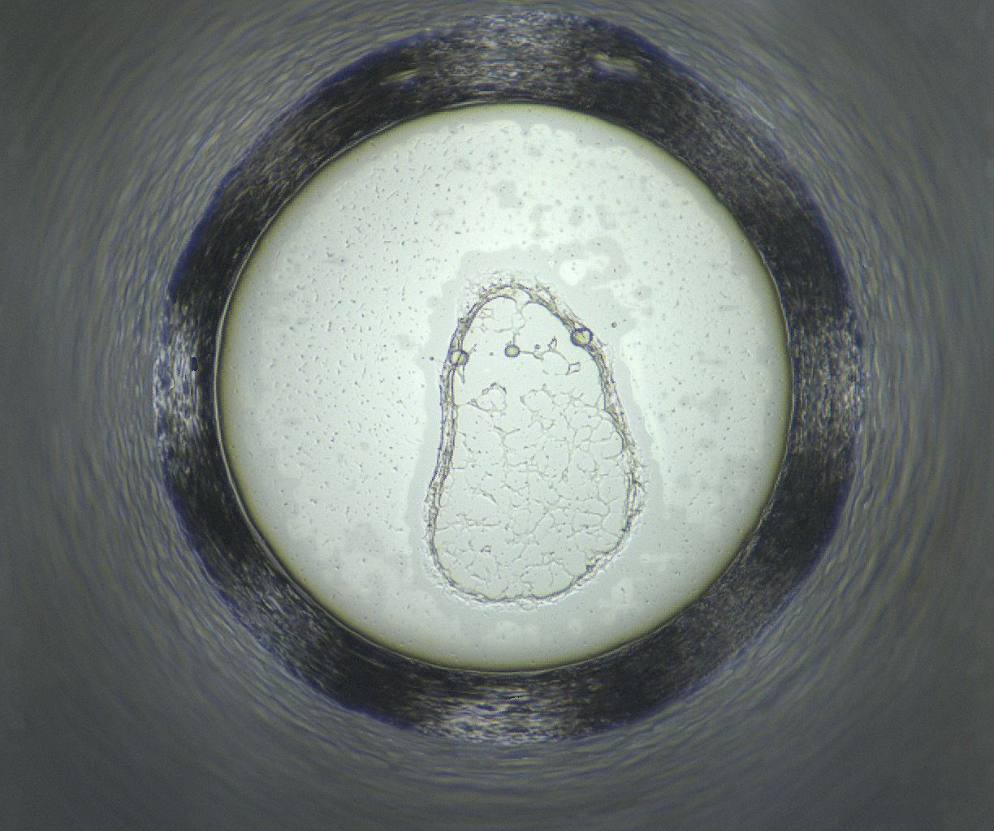
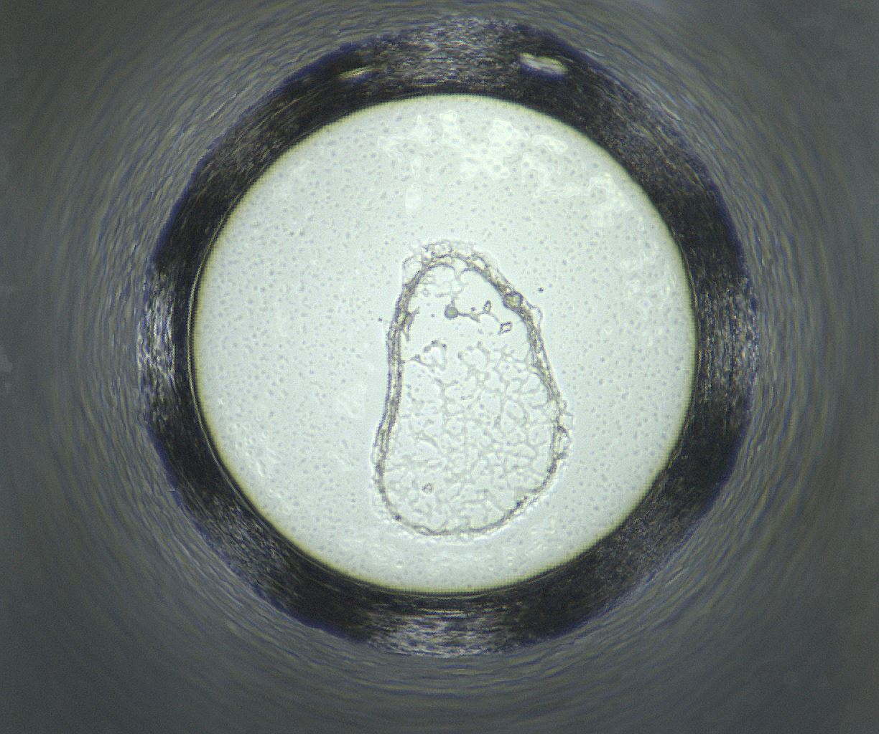
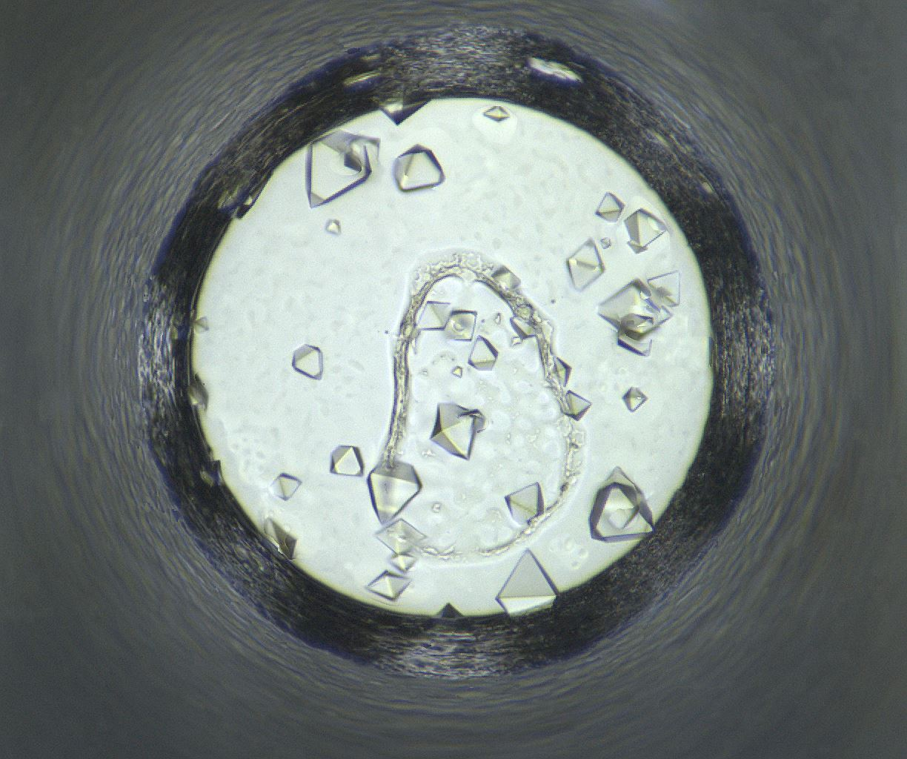
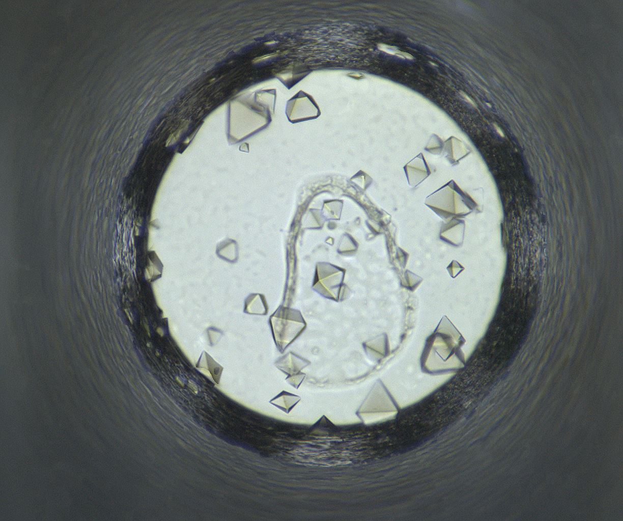
Well 700: 04/07/2020 - 05/19/2020
04/07/2020
04/08/2020
04/14/2020
04/21/2020
04/28/2020
05/05/2020
05/19/2020

Slide 14
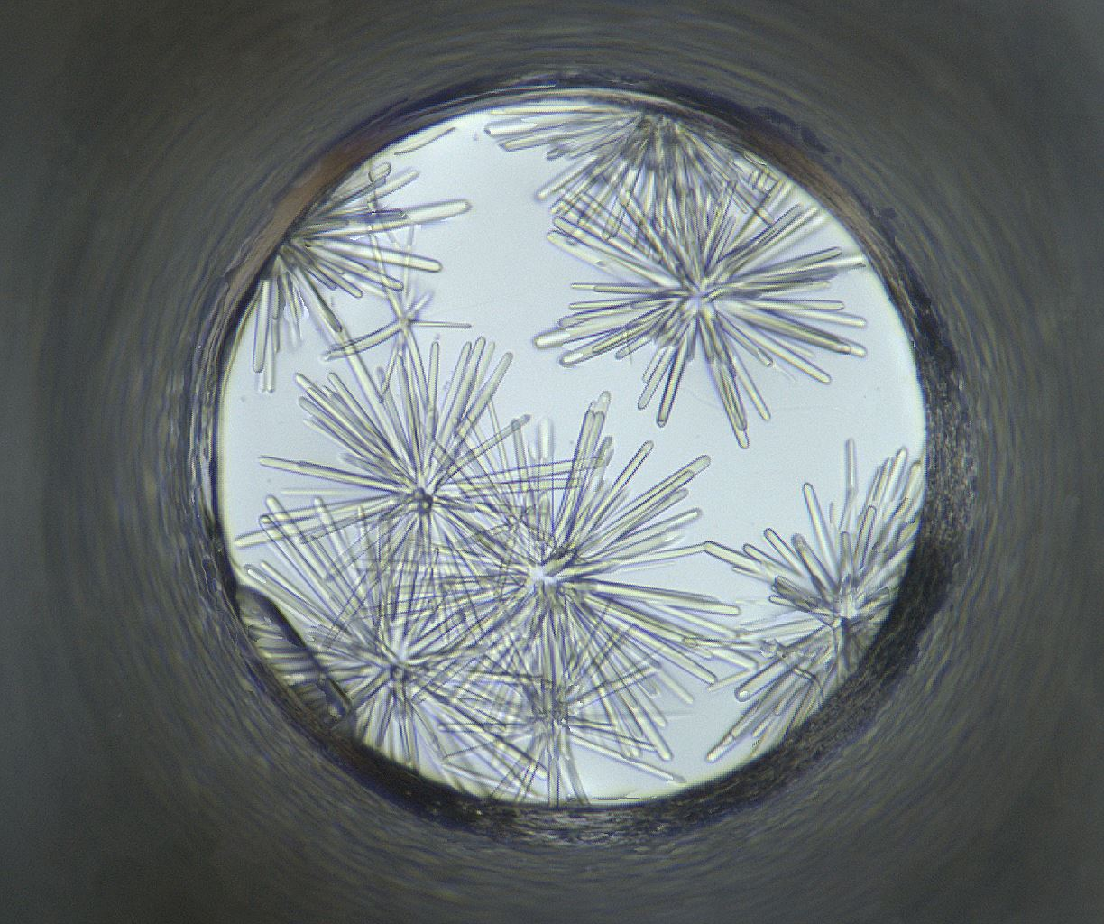
Well Number 1148
Well Num: 1148 MARCO Class: Crystals Human Class: Crystals MARCO Confidence: 93.5 % Date: 05/19/2020 Spectrum: Visible Cocktail 17_C1511 ------------------ pH: 7 Lithium sulfate monohydrate 1.5 M bis-tris propane 0.1 M

Slide 15
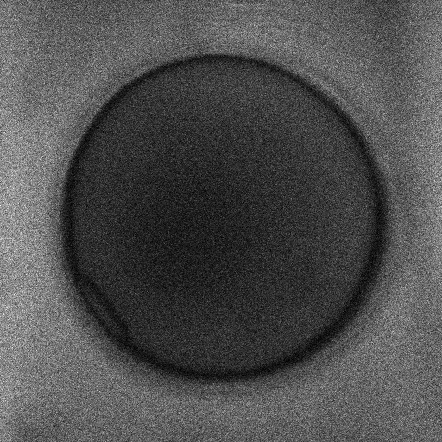
Well 1148 Alternate Imagers
Visible
UV-TPEF

Slide 16
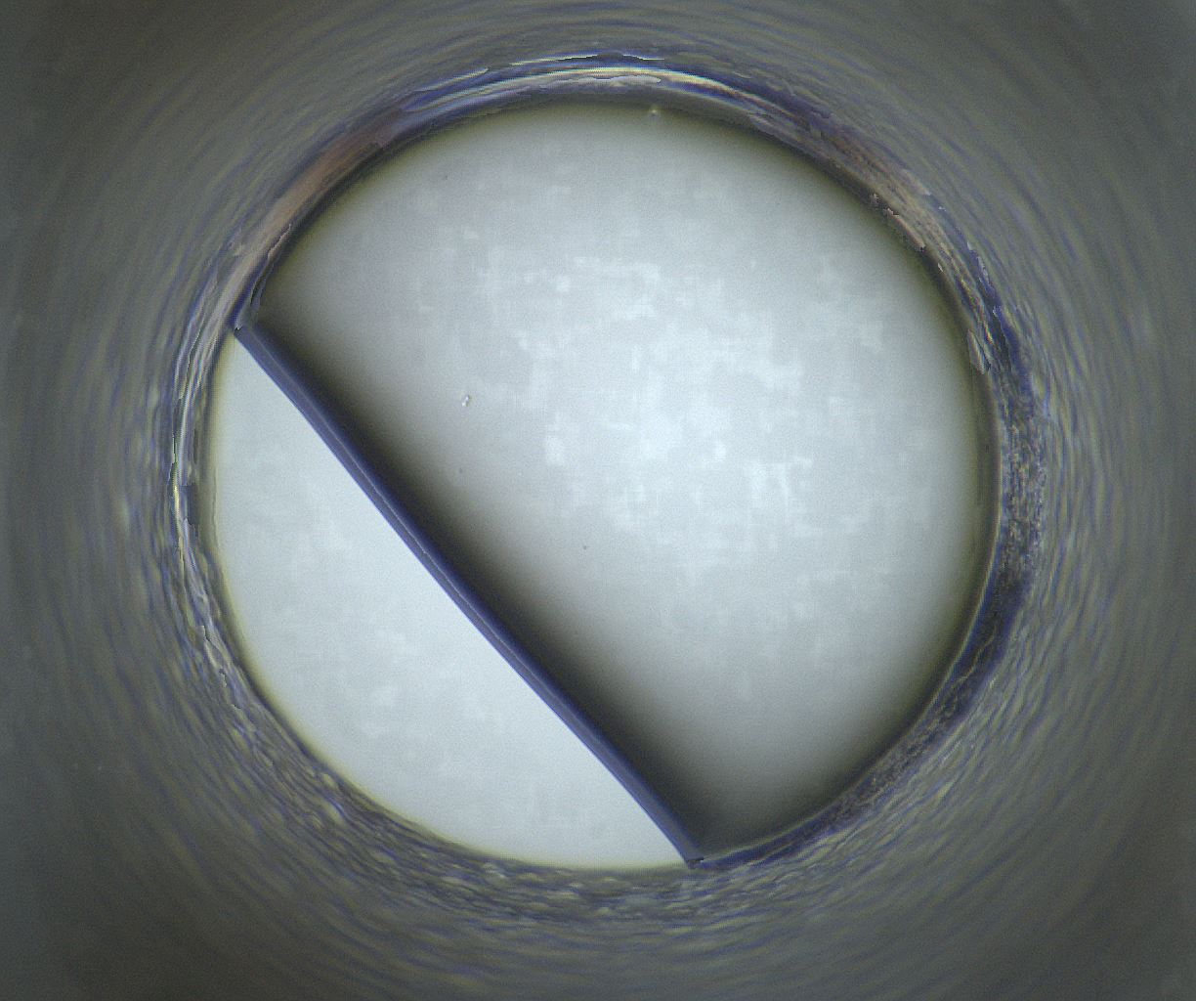
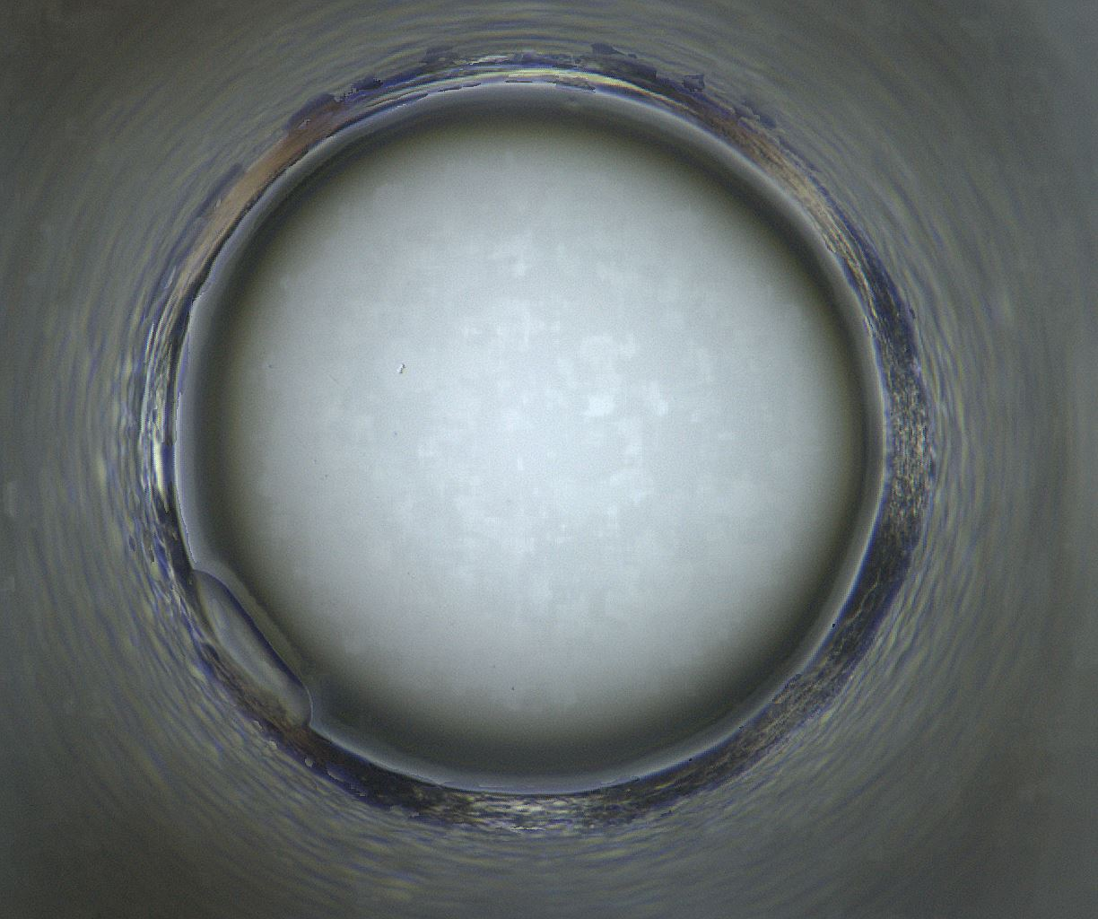
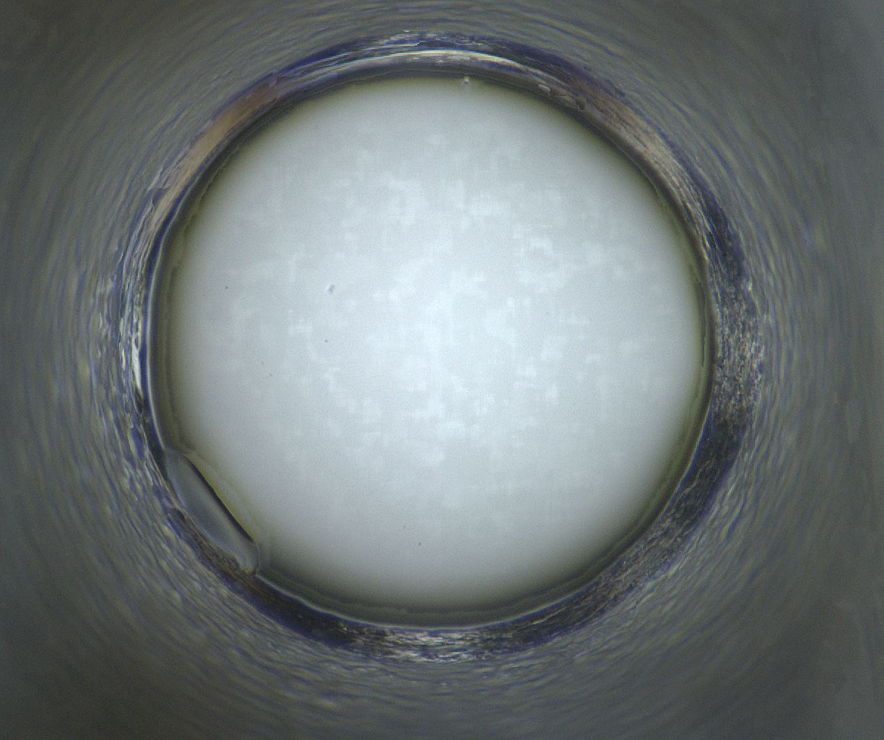
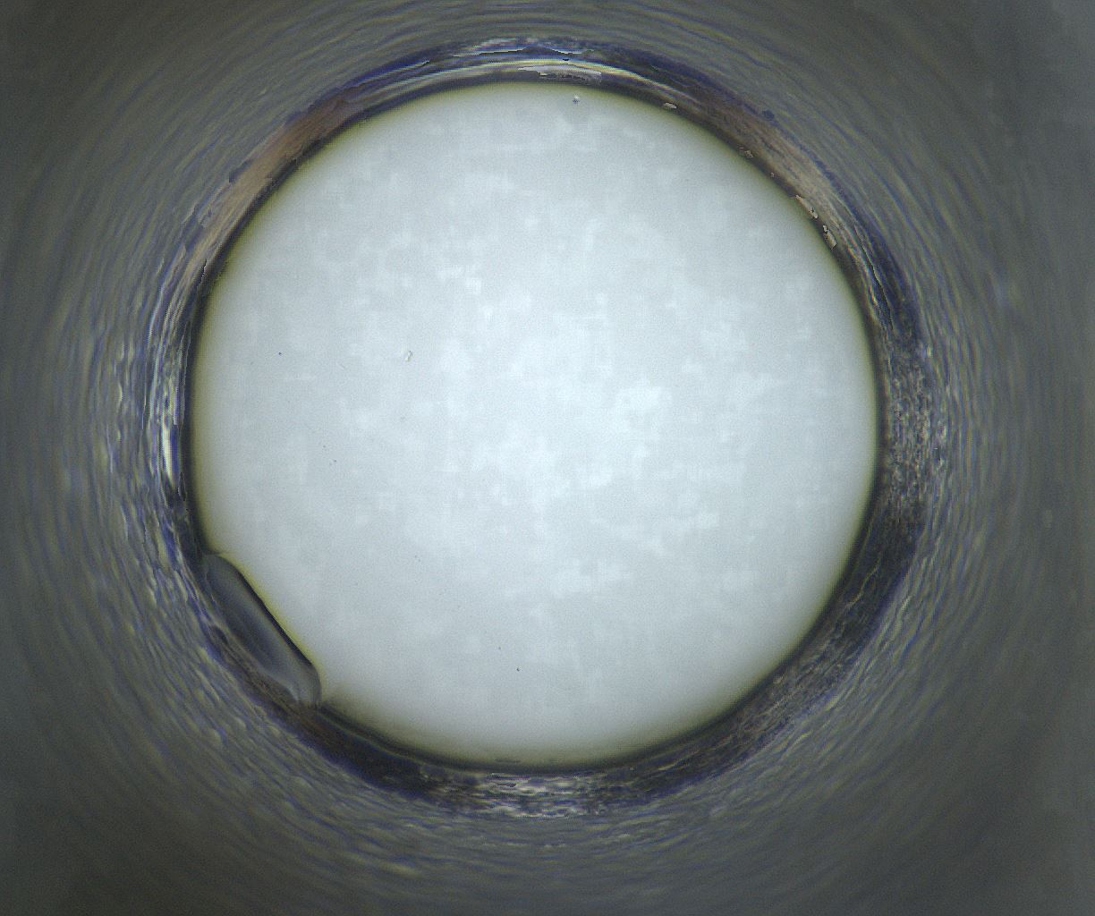
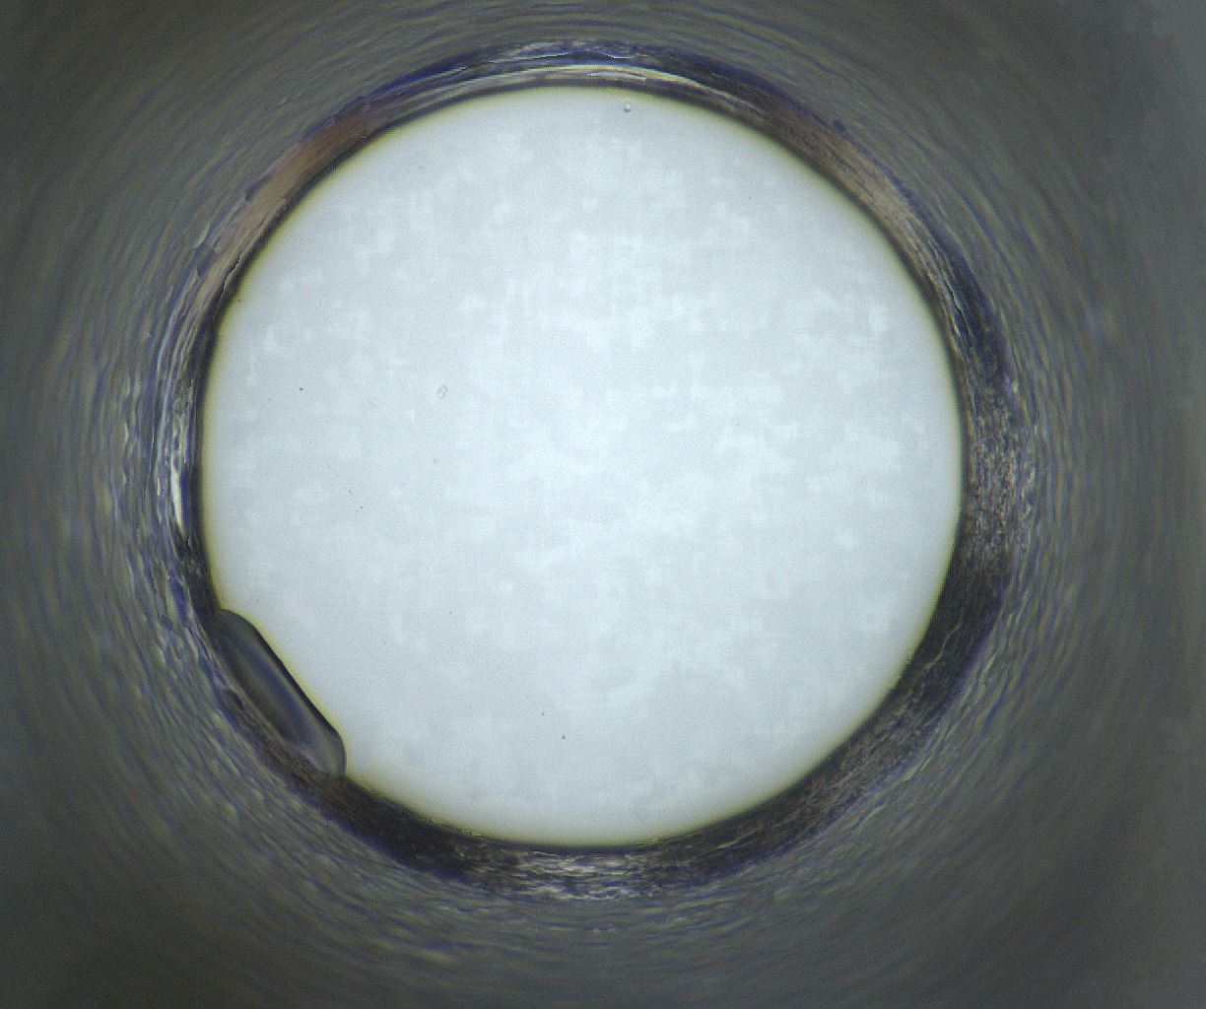
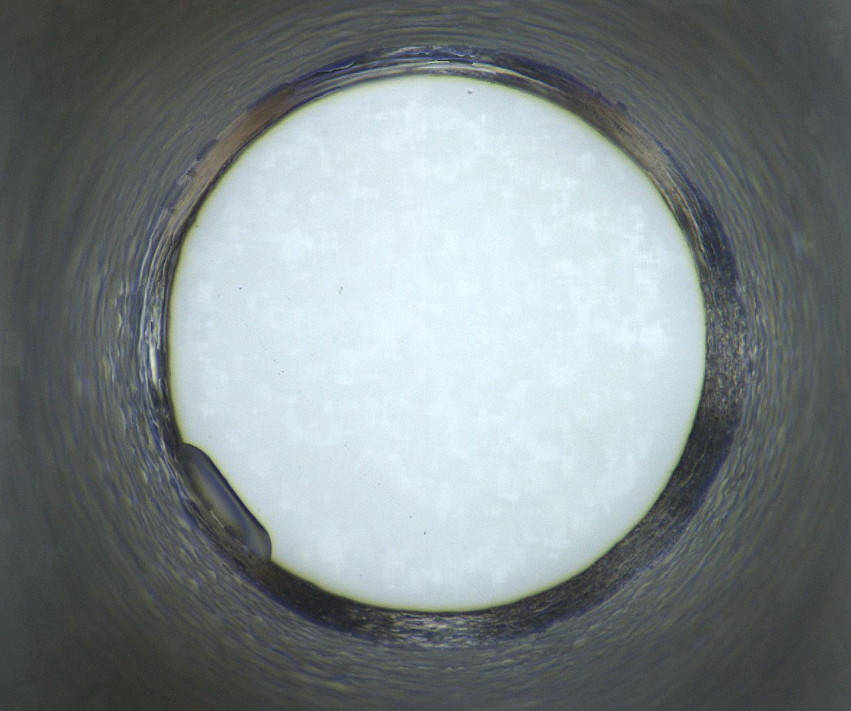
Well 1148: 04/07/2020 - 05/19/2020
04/07/2020
04/08/2020
04/14/2020
04/21/2020
04/28/2020
05/05/2020
05/19/2020

Slide 17
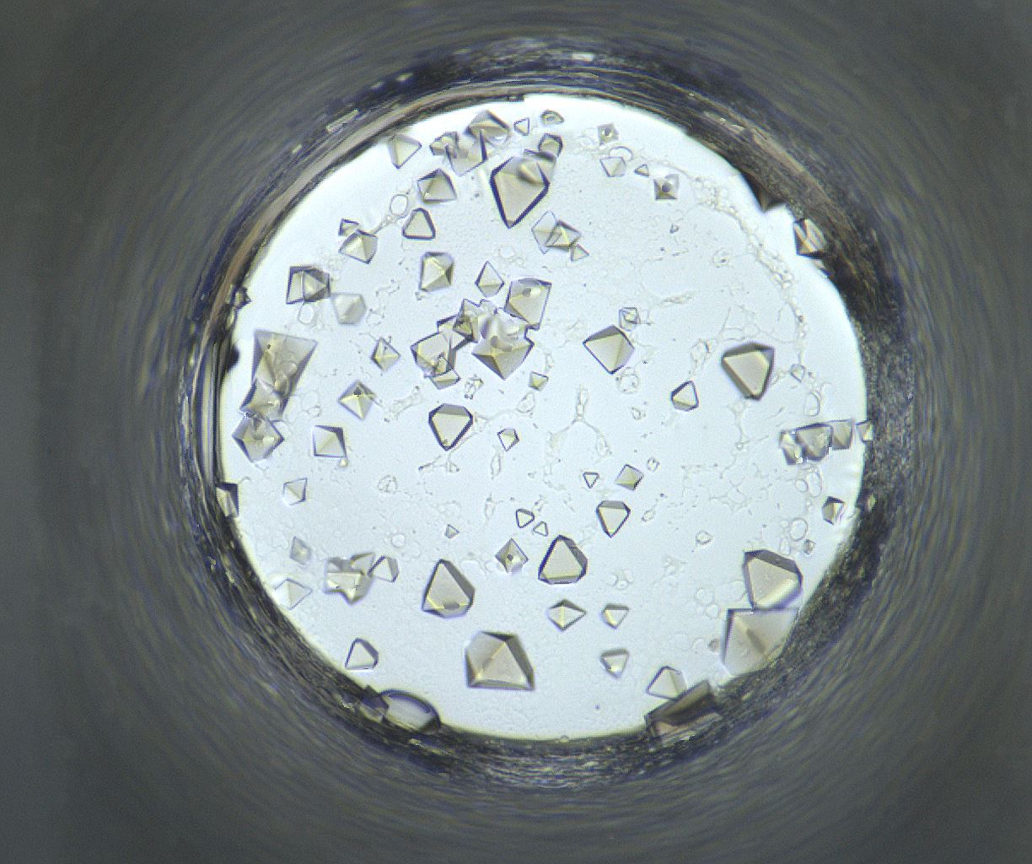
Well Number 1276
Well Num: 1276 MARCO Class: Crystals Human Class: Crystals MARCO Confidence: 94.0 % Date: 05/19/2020 Spectrum: Visible Cocktail 17_C1135 ------------------ pH: 6.8 Silver Bullet G7 [] [] HEPES 0.06 M PEG 3350 15.0 w/v

Slide 18
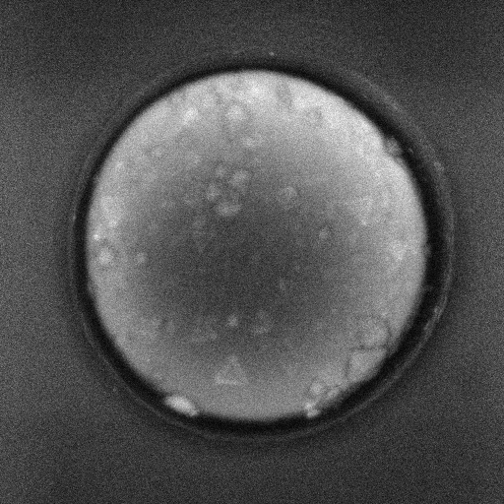
Well 1276 Alternate Imagers
Visible
UV-TPEF

Slide 19
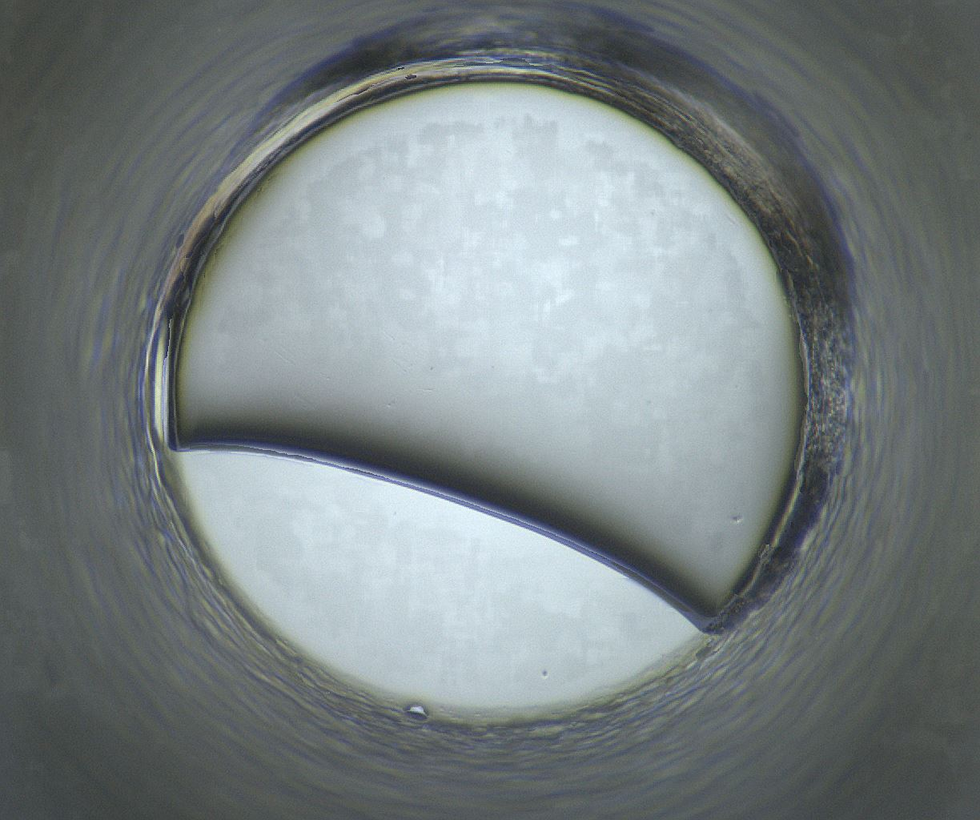
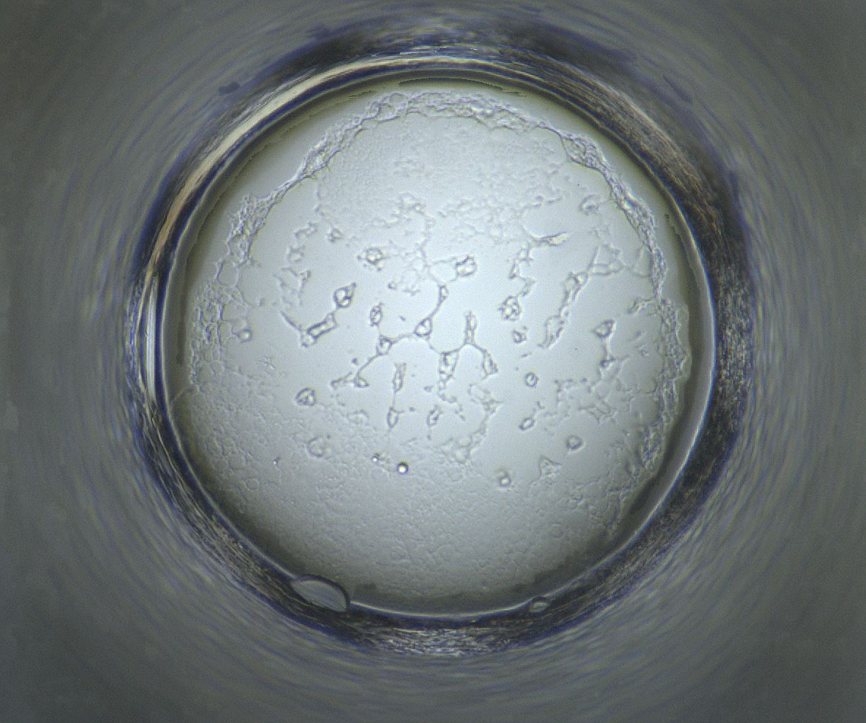
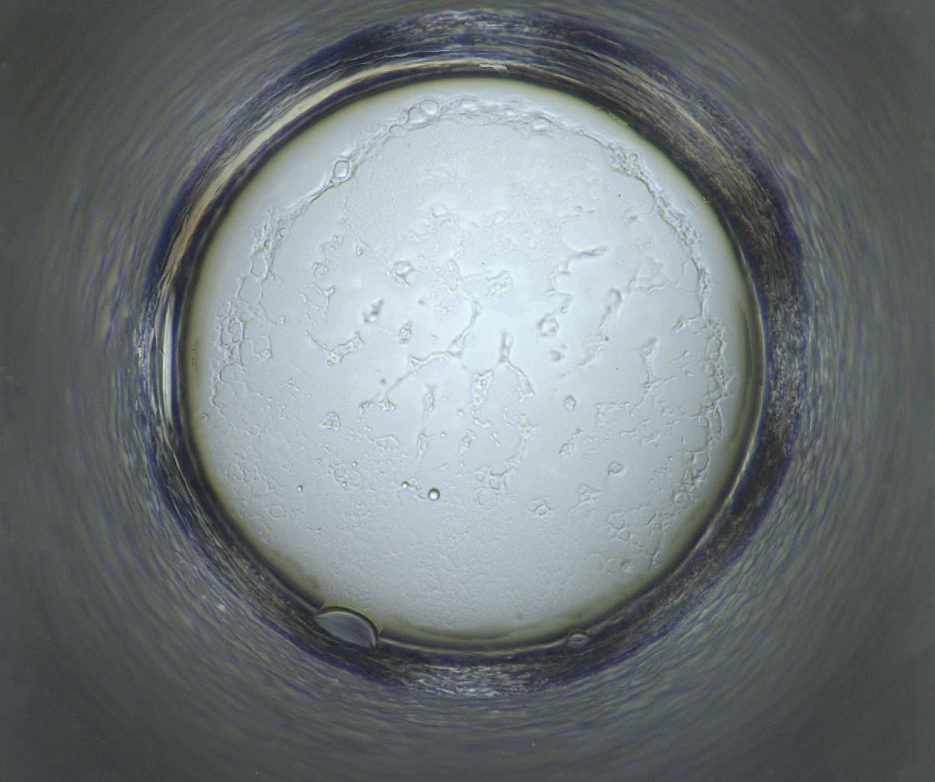
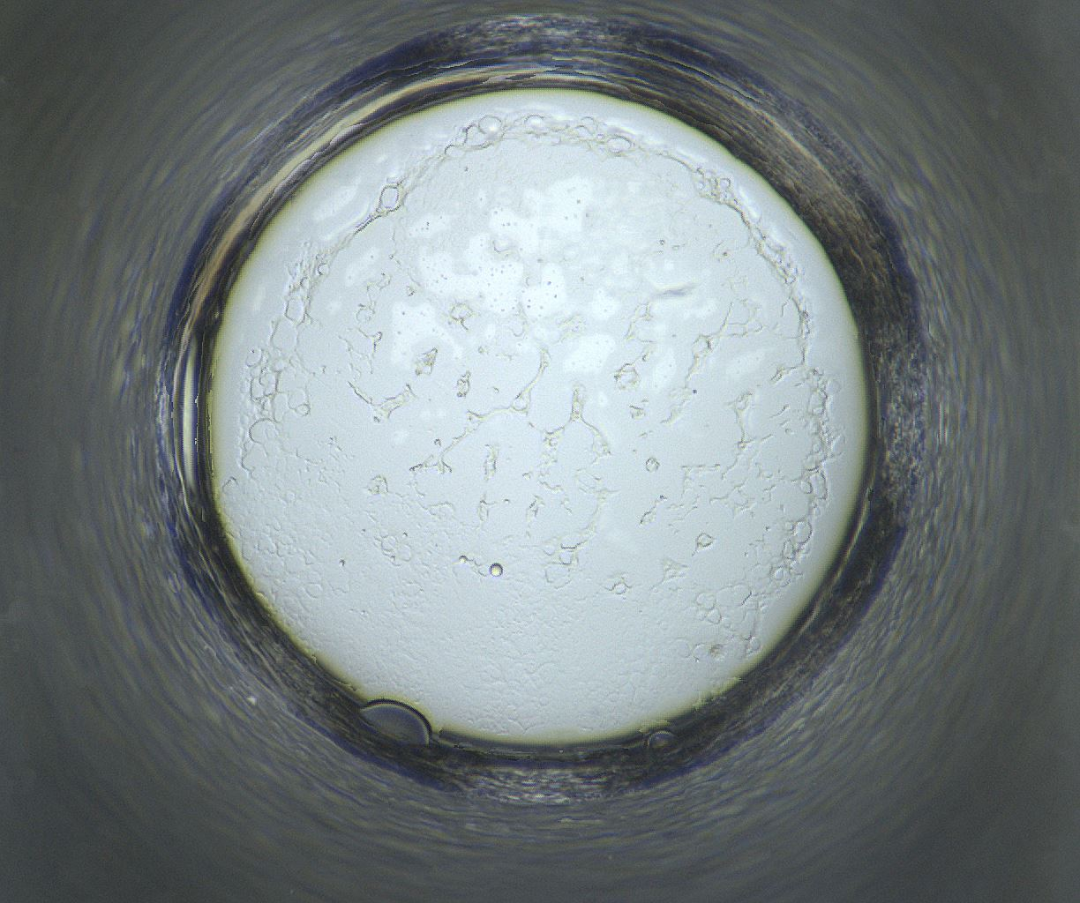
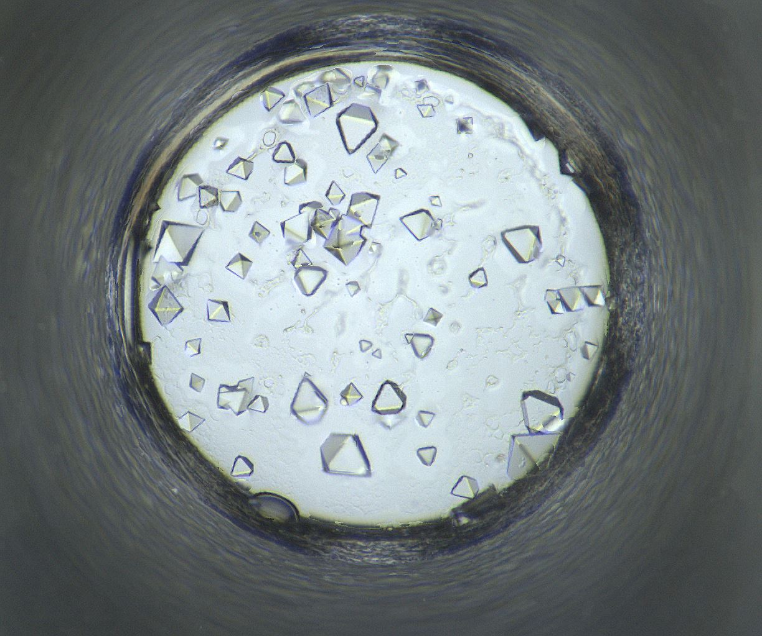
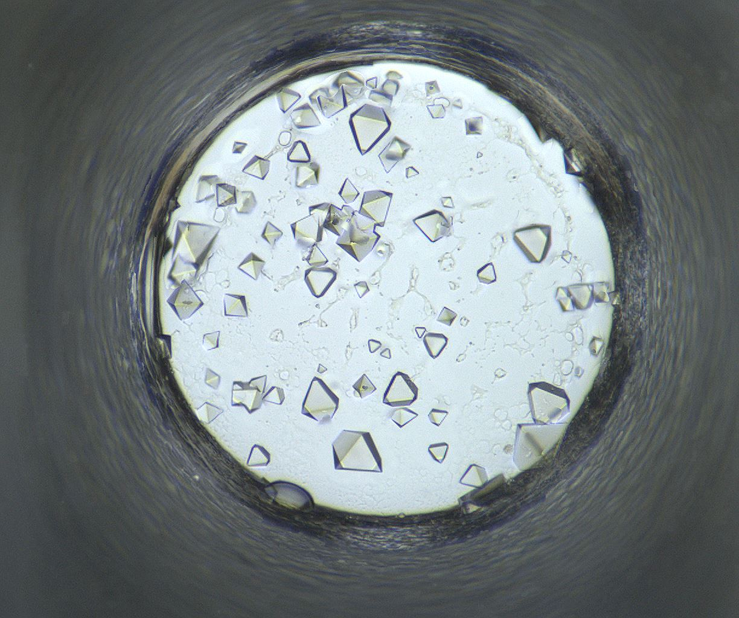
Well 1276: 04/07/2020 - 05/19/2020
04/07/2020
04/08/2020
04/14/2020
04/21/2020
04/28/2020
05/05/2020
05/19/2020

Slide 20
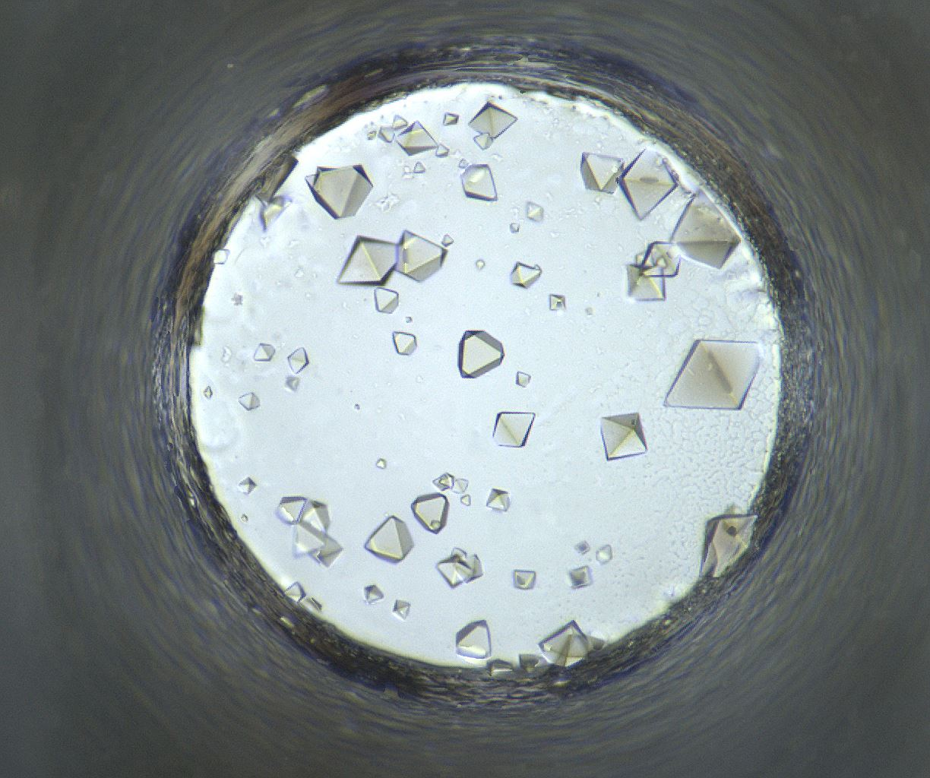
Well Number 1280
Well Num: 1280 MARCO Class: Crystals Human Class: Crystals MARCO Confidence: 93.5 % Date: 05/19/2020 Spectrum: Visible Cocktail 17_C1136 ------------------ pH: 6.8 Silver Bullet G8 [] [] HEPES 0.06 M PEG 3350 15.0 w/v

Slide 21
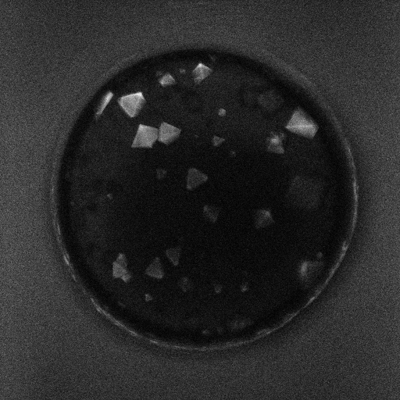
Well 1280 Alternate Imagers
Visible
UV-TPEF

Slide 22






Well 1280: 04/07/2020 - 05/19/2020
04/07/2020
04/08/2020
04/14/2020
04/21/2020
04/28/2020
05/05/2020
05/19/2020

Slide 23

Well Number 1417
Well Num: 1417 MARCO Class: Crystals Human Class: Crystals MARCO Confidence: 94.1 % Date: 05/19/2020 Spectrum: Visible Cocktail 17_C0475 ------------------ pH: 7.5 Ammonium nitrate 0.1 M HEPES 0.1 M PEG 8000 40.0 w/v

Slide 24

Well 1417 Alternate Imagers
Visible
UV-TPEF

Slide 25






Well 1417: 04/07/2020 - 05/19/2020
04/07/2020
04/08/2020
04/14/2020
04/21/2020
04/28/2020
05/05/2020
05/19/2020

Slide 26

Well Number 1464
Well Num: 1464 MARCO Class: Crystals Human Class: Crystals MARCO Confidence: 93.8 % Date: 05/19/2020 Spectrum: Visible Cocktail 17_C1146 ------------------ pH: 6.8 Silver Bullet H6 [] [] HEPES 0.06 M PEG 3350 15.0 w/v

Slide 27

Well 1464 Alternate Imagers
Visible
UV-TPEF

Slide 28






Well 1464: 04/07/2020 - 05/19/2020
04/07/2020
04/08/2020
04/14/2020
04/21/2020
04/28/2020
05/05/2020
05/19/2020

Slide 29

Well Number 1476
Well Num: 1476 MARCO Class: Crystals Human Class: Crystals MARCO Confidence: 93.7 % Date: 05/19/2020 Spectrum: Visible Cocktail 17_C1149 ------------------ pH: 6.8 Silver Bullet H9 [] [] HEPES 0.06 M PEG 3350 15.0 w/v

Slide 30

Well 1476 Alternate Imagers
Visible
UV-TPEF

Slide 31






Well 1476: 04/07/2020 - 05/19/2020
04/07/2020
04/08/2020
04/14/2020
04/21/2020
04/28/2020
05/05/2020
05/19/2020

